Slide 1



Slide 2
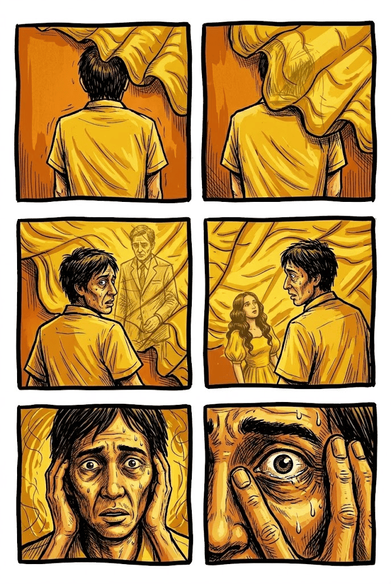


Objectives:
At the end of the lesson, learners are expected to:
Describe the role of the yellow shawl, mirror, and multiple perspectives in the short story;
Interpret how shifting perspectives and recurring symbols reveal characters’ emotions, memories, and conflicts;
Demonstrate sensitivity and understanding on the emotional experiences of the characters; and
Observe how the portrayal of characters’ memories, love and sacrifices reflect on the Filipino values and experiences.

Slide 3
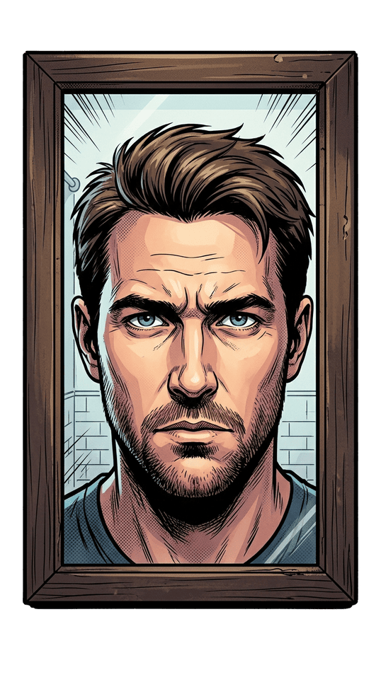
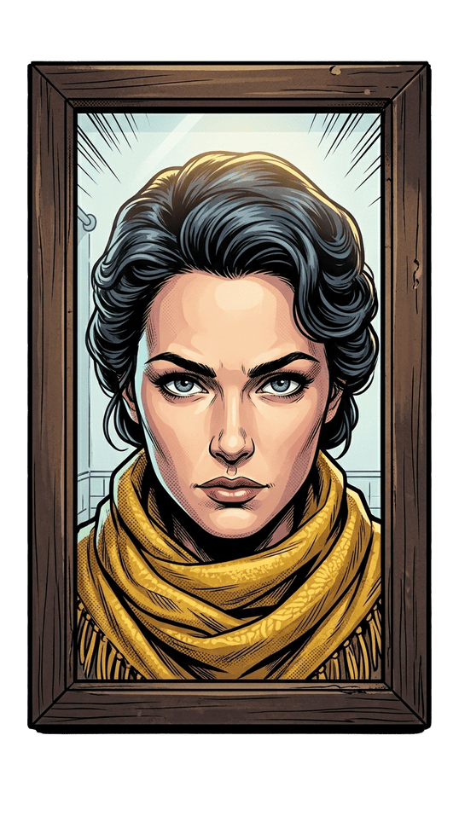
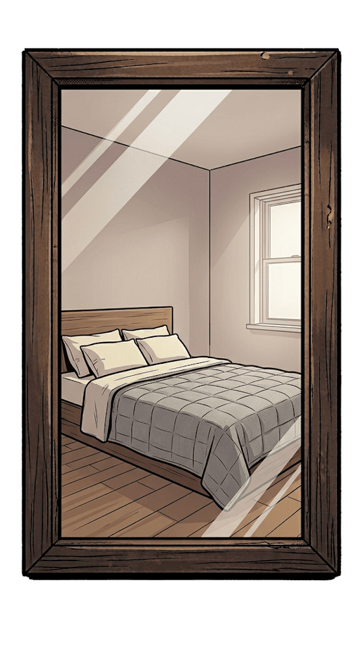

Slide 4
THE YELLOW SHAWL
  While reading the short story, a yellow shawl will appear at certain points.
  Along with the yellow shawl, questions related to the short story will be presented. The story can only progress if the questions are answered correctly. If a student answers incorrectly, they will be taken back to the part of the story where the answer can be found. They must reread that section and answer the question again. Once the correct answer is given, they may proceed to the next part of the story.
  If a question includes an image, click on the image to check your answer. If the answer is correct, the story will proceed to the next part. If the answer is incorrect, you will be taken back to the section of the story where the answer can be found, and you will need to reread it before answering the question again.
  If a question is opinion-based, the teacher will evaluate the student's response. If the answer is satisfactory, the teacher should click the yellow shawl. If the answer is not satisfactory, the teacher should click the mirror.

Slide 5

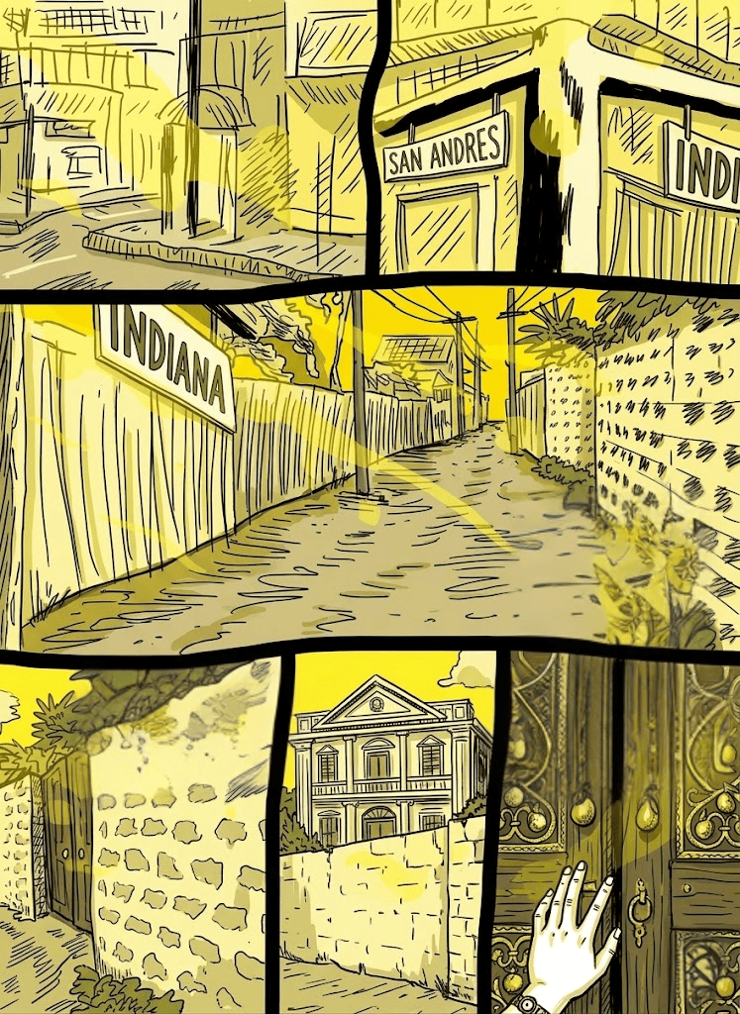
P
epe has a new place; but it wasn't hard to find. It is only a block away from Taft Avenue and about a hundred yards off San Andres corner. The street is not a first class street, it is practically a dirt road, but it is very quiet. You wouldn't believe it is within a stone's throw of the city's great south national highway.

Slide 6
The place is impressive. It is an apartment building that doesn't look like one at all. It looks more like a mansion. That is probably what it was, a rich man's home, before it was converted into a hostelry.
A wall almost a man's height surrounds it. The gate, two panels of very heavy wood with inlaid beaten brass filigree work, this afterns on vas ajar-open only wide enough to admit one person at a time.

Slide 7
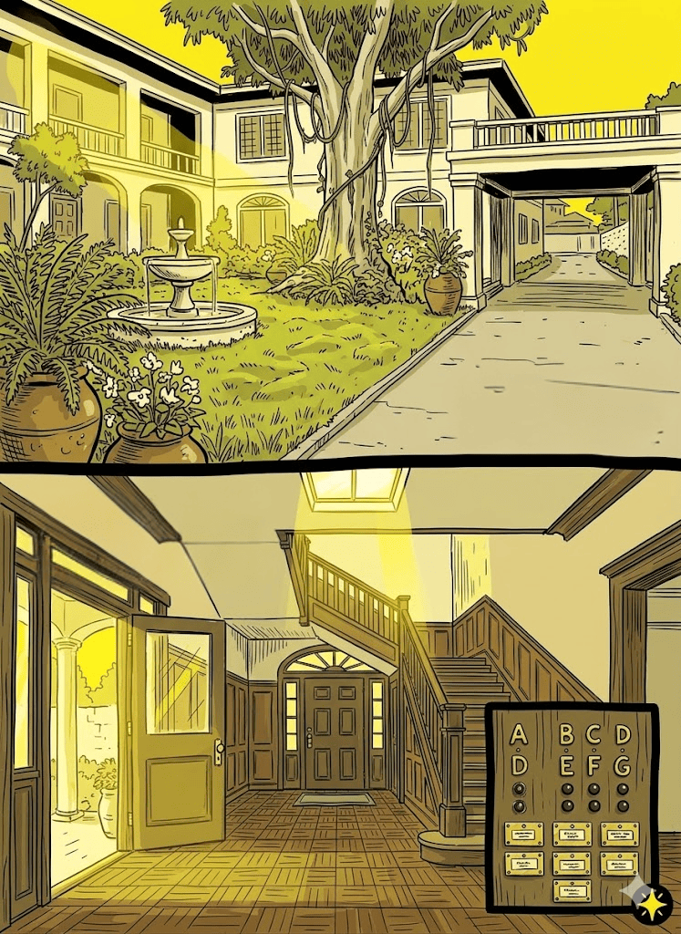
In the courtyard was a eucalyptus with liana vines, a fountain, a lot of ferns and flowering plants in huge pots, and a square lawn of thick Bermuda grass that has begun to bulge in places.

Slide 8
A concrete driveway leads beneath a porte-cochère, up beside the building, and disappears into the back.

Slide 9
I saw two entrances, a wider side entrance and a front one. I used the front entrance.

Slide 10
How did the man describe the exterior of the place?

Slide 12
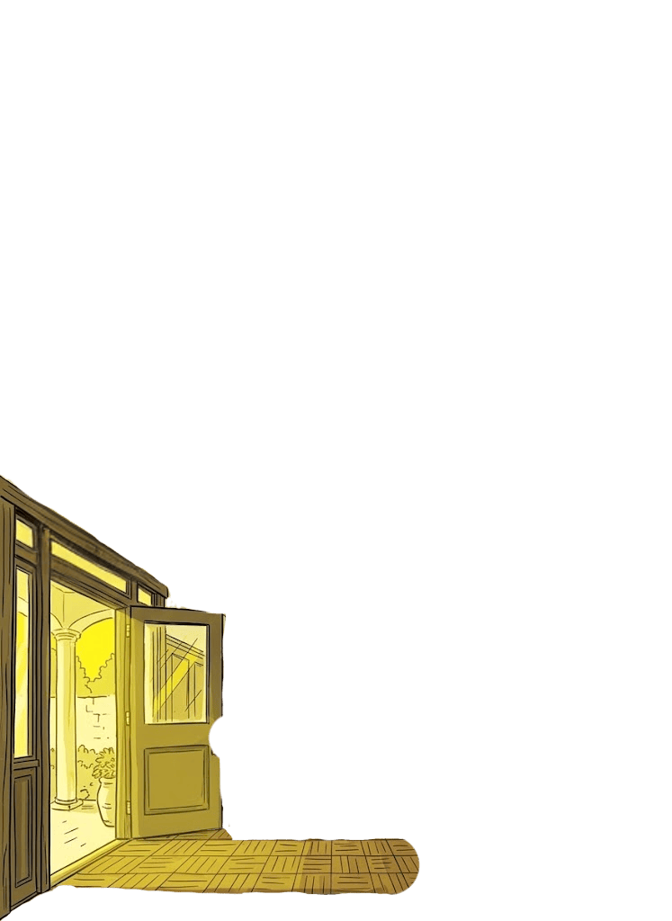
A flight of three concrete steps leads to an exposed square concrete landing. The door is tall, the lower third of stout oakwood, the upper two-thirds of Florentine glass and ironwork.

Slide 13
Inside, it was very cool. And it wasn't dim at all. Light came from the front door and the open side entrance. There was a central skylight above the system of stairs.

Slide 14
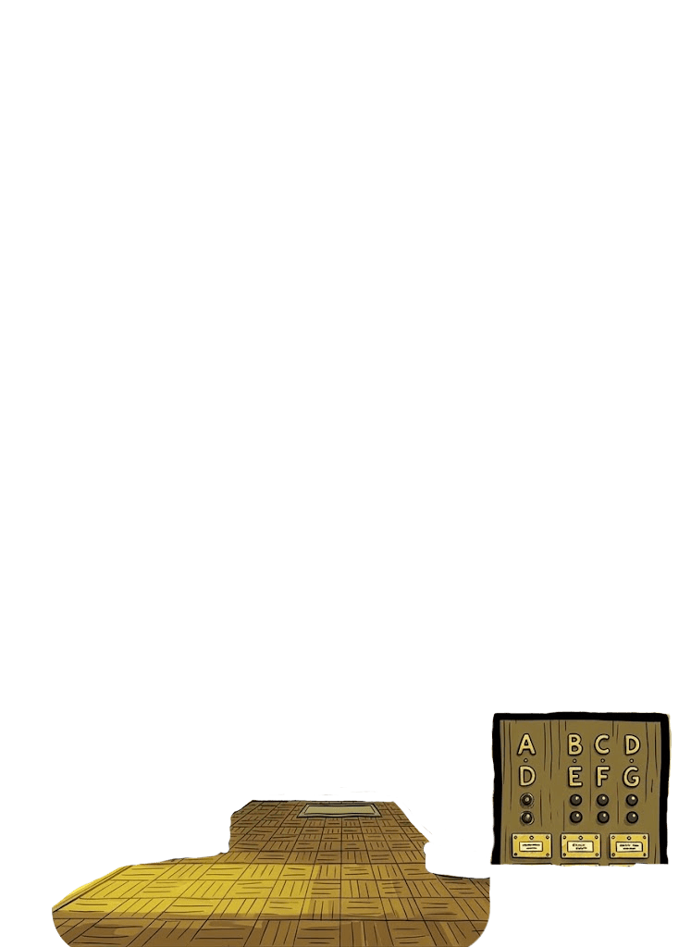
The panelling and the parquet flooring are all of strong rich brown oakwood. Against the wall near the foot of the first flight of steps are the letter boxes with the name cards and the black buttons with, above them, the cutout brass letters from A to G.

Slide 15
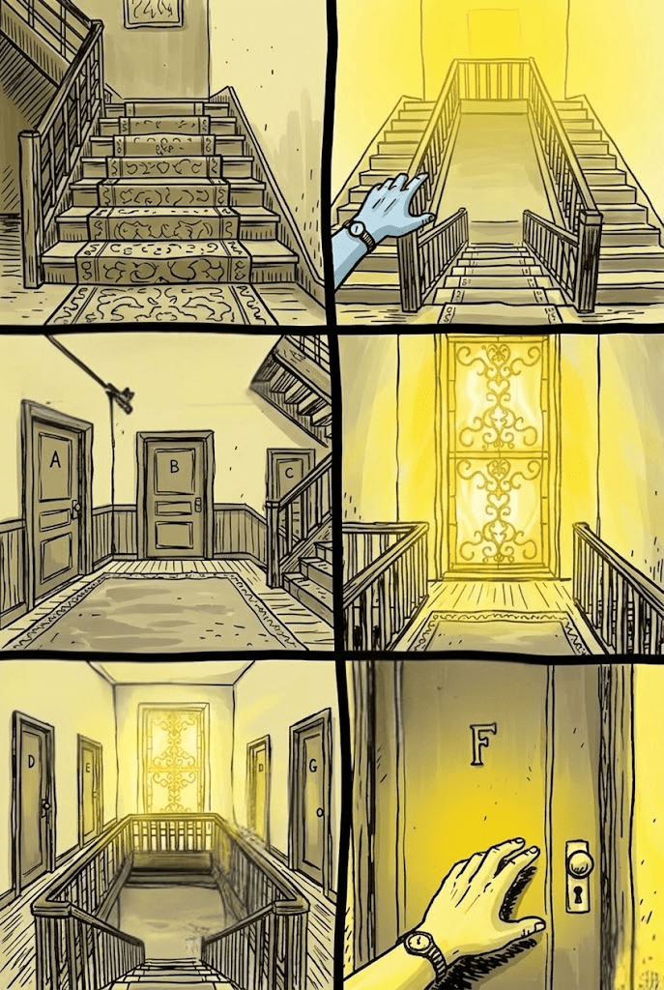

The first stairs are wide and carpeted. Opening on to the first landing also covered with a rug, are three doors- these are Apartments A, B, and C.

Slide 16
Two narrow flights ascend from the first landing on either side of the first stairs. A long strip of rug covers all seven steps.

Slide 17
The second square landing ends in a tall window also of Florentine glass. Two narrow passageways, railed off from the stairwell, connect the landing with a long hall.

Slide 18
Four doors, two on either side, open onto this hall--Apartments D and E towards the rear and Apartments F and G forward. The hall is dominated by another window, again of Florentine glass.

Slide 19
Apartment F is Pepe's.

Slide 20

According to the man, the floors of the rooms are dominated by what?
Florentine glass
Doors
Stairs

Slide 21
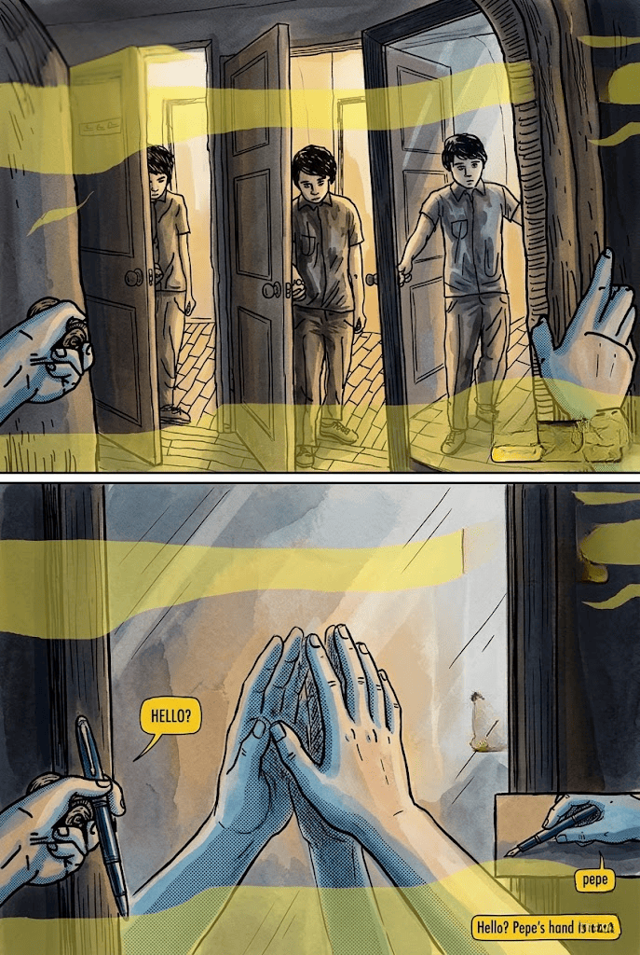
When I pushed the door in, I saw in the wall facing me, even as the door swung open, another door opening, swinging outward, toward where I stood, out in the hall before the apartment. The doors came to a stand simultaneously. I noticed the man before the farther side of the inner door, I stood and waited.

Slide 22
It seemed the man could sustain silence and stillness longer than I could, so I decided to call out to him. Before I did so, I stepped over the threshold. When I saw him stride through the inner door the same time I crossed the threshold, I realized it was a mirror before me, a tall wall mirror.

Slide 23
The vestibule was bare.
The mirror was in the front room, set in a wall section directly facing the entranceway from the vestibule into the front room.

Slide 24
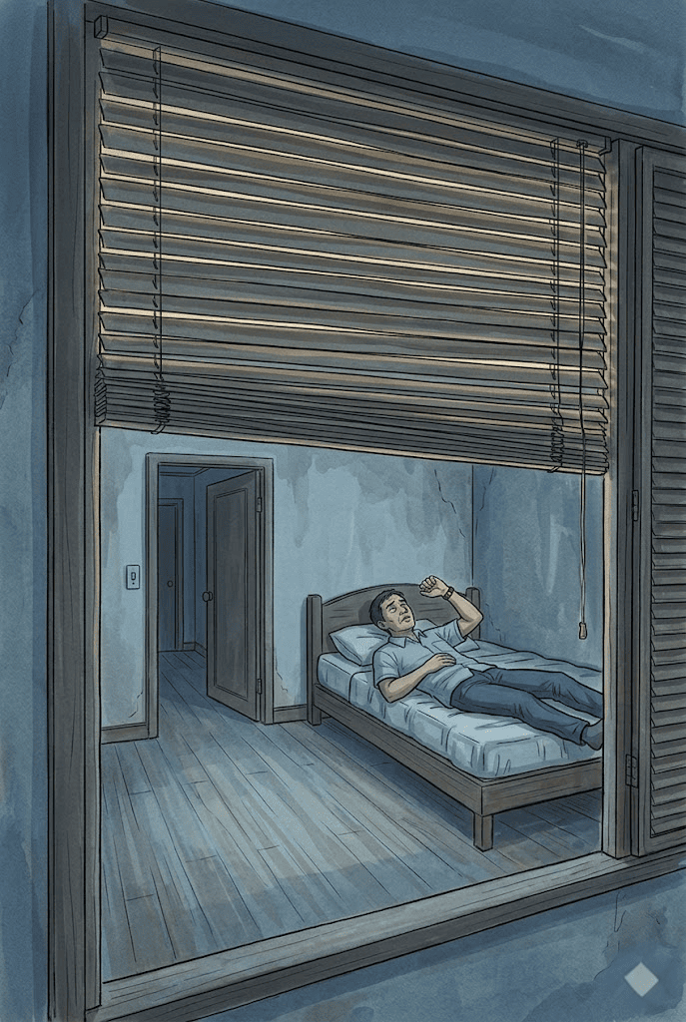
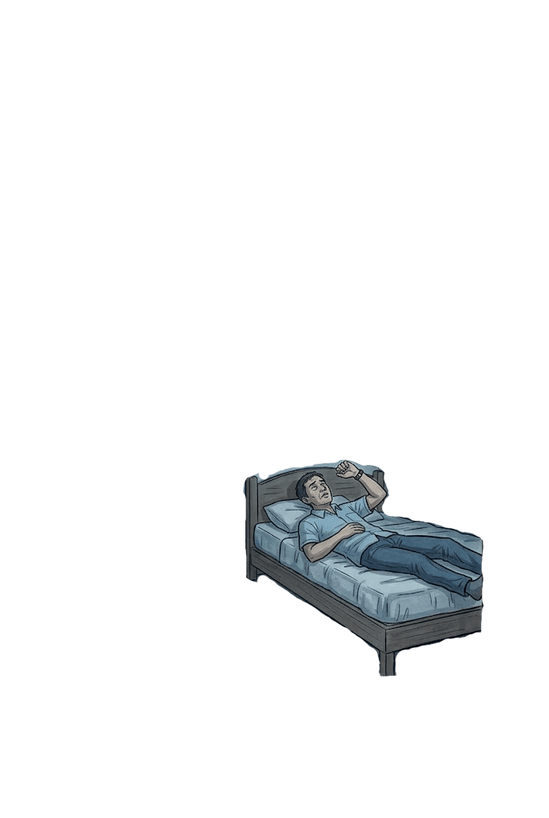
The front room was long and rectangular. There was a wide square back room. I went to the back room. I sat on Pepe's bed. I took off my shoes but left my feet soaked. I stretched out on the bed to wait.

Slide 25
The front room was long and rectangular. There was a wide square back room. I went to the back room. I sat on Pepe's bed. I took off my shoes but left my feet soaked. I stretched out on the bed to wait.
I hadn't had lunch and I was very tired but I wanted to be sure to be there when she arrived.
I looked at my wrist watch. It was a quarter to two.

Slide 26
Are you willing to do what he is doing while waiting for someone?

Slide 27
She didn't come until about three hours later. I waited, lying in Pepe's bed. The apartments were quiet. In the silence I could barely make out the hum of the traffic a block away. The afternoon was warm but it was cool in the apartment.

Slide 28
She didn't come until about three hours later. I waited, lying in Pepe's bed. The apartments were quiet. In the silence I could barely make out the hum of the traffic a block away. The afternoon was warm but it was cool in the apartment.
There was a window in the front room, the only one in the apartment, but it was a tall massive window; it looked as if all of the front wall had been knocked out for it.

Slide 29
She didn't come until about three hours later. I waited, lying in Pepe's bed. The apartments were quiet. In the silence I could barely make out the hum of the traffic a block away. The afternoon was warm but it was cool in the apartment.
There was a window in the front room, the only one in the apartment, but it was a tall massive window; it looked as if all of the front wall had been knocked out for it.
The window was completely covered by drawn blinds. There were concealed ventilators. I could sense rather than hear them but I didn't bother to find out where they were.

Slide 30
What time did she arrive?
3:45 p.m
4:45 p.m
5:45 p.m

Slide 31
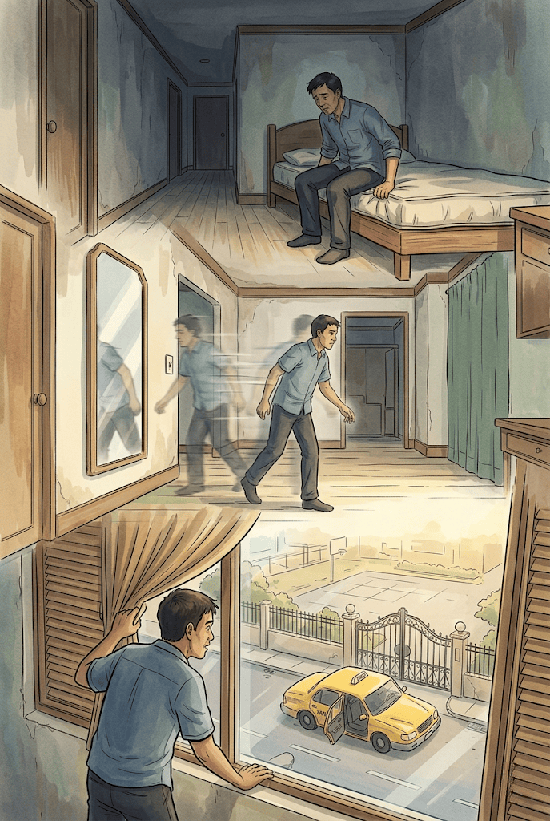
A hoe drummed the earth in the public garden across the street. Water was run into pails and then after a while sprinkled on earth. Children laughed and shouted in the schoolyard a block away in the direction of the church and the sea. Even the sighing of the surf in the sea, I imagined, came to me.

Slide 32
Everytime I heard a car turning into the street I sat up in bed. As the car approached I would swing out of bed and run to the window. I would pull back the blinds and, through the gap between the side of the kind and the window jamb, I would look into the street below. I did not leave the window until after each car left.

Slide 33
To and from the window, I passed the mirror every time. From the corner of my eye, I would catch a glimpse of my image as it entered, momentarily occupied, then left the silver frame.

Slide 34

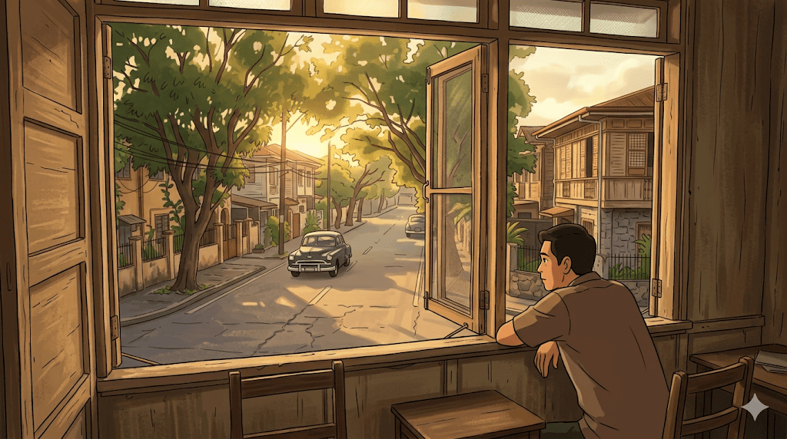
Not many cars turned into Indiana Street that afternoon. But even so, some time during my vigil, I lost count. I decided she was probably not showing up at all. Every time I came away from the window I would tell myself that if she weren't in the next car I would leave. But I never did. I had borrowed the apartment for that afternoon and the afternoon was not over yet.
The children were not in the school grounds any more and I could hear the sea very clearly when she came.
I swung out of bed when I heard the car turning into the street. I was feeling weak and a little light headed. I sat on the edge of the bed and held on to the thickness of the mattress to keep from keeling forward.

Slide 35
Not many cars turned into Indiana Street that afternoon. But even so, some time during my vigil, I lost count. I decided she was probably not showing up at all. Every time I came away from the window I would tell myself that if she weren't in the next car I would leave. But I never did. I had borrowed the apartment for that afternoon and the afternoon was not over yet.
The children were not in the school grounds any more and I could hear the sea very clearly when she came.
I swung out of bed when I heard the car turning into the street. I was feeling weak and a little light headed. I sat on the edge of the bed and held on to the thickness of the mattress to keep from keeling forward.

Slide 36
Not many cars turned into Indiana Street that afternoon. But even so, some time during my vigil, I lost count. I decided she was probably not showing up at all. Every time I came away from the window I would tell myself that if she weren't in the next car I would leave. But I never did. I had borrowed the apartment for that afternoon and the afternoon was not over yet.
The children were not in the school grounds any more and I could hear the sea very clearly when she came.
I swung out of bed when I heard the car turning into the street. I was feeling weak and a little light headed. I sat on the edge of the bed and held on to the thickness of the mattress to keep from keeling forward.

Slide 37
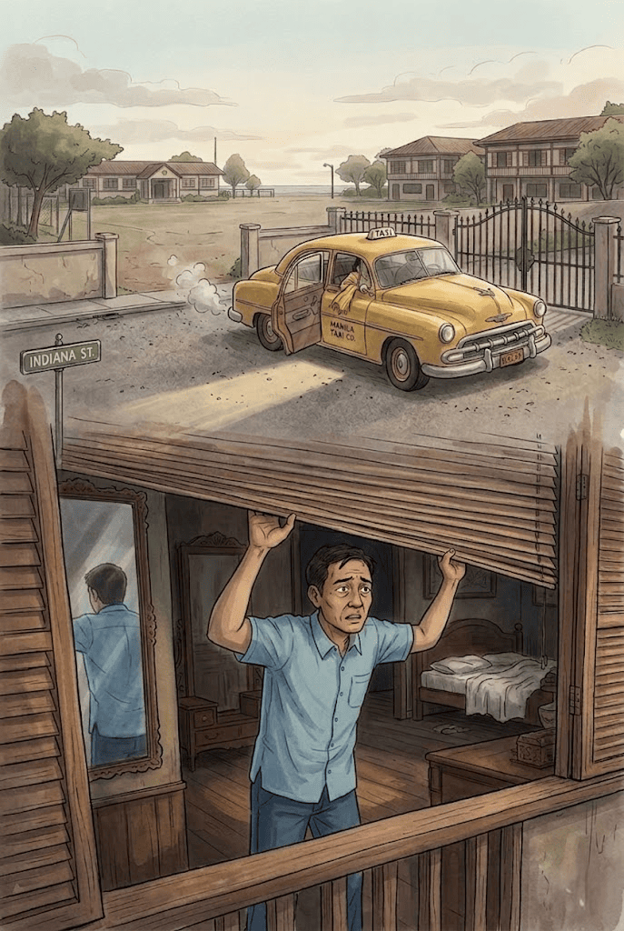
I rose to my feet unsteadily when I heard the car slowing down.

Slide 38
I was already in the front room when the sound of the tires gripping the gravel reached me.

Slide 39
I was striding past the mirror as the car screeched to a stop.

Slide 40
I reached the window, pulled back the blinds, and looked down into the street. The cab was drawn up before the gate, its engine running. The cab door swung open.

Slide 41
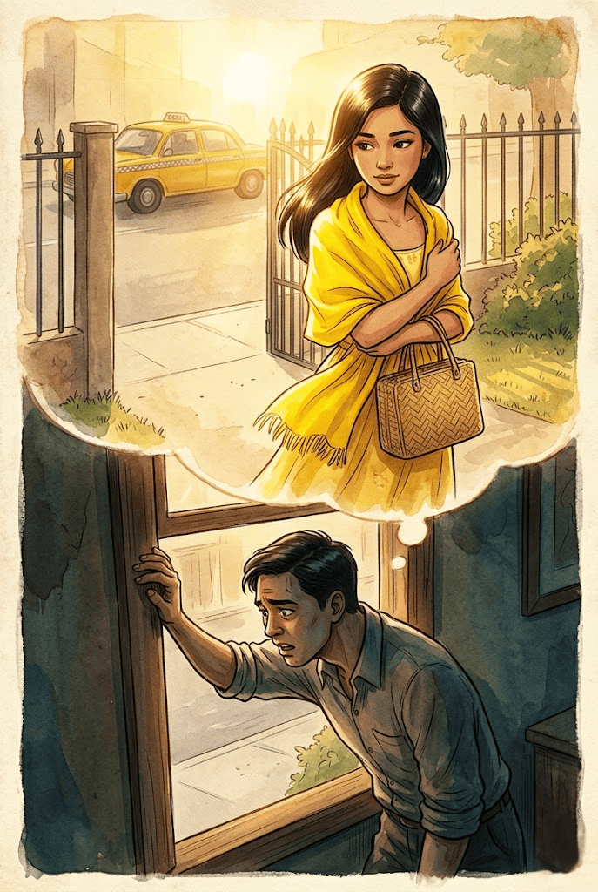
I was leaning against the window jamb. Suddenly, above the purring of the idling engine, I could hear my rasping breath.

Slide 42
I saw her foot as it settled upon the car door sill. It was in a yellow sandal. I caught glimpse of the swish of the hem of a yellow dress.

Slide 43
The late afternoon sun was sudden, caught in her gleaming hair, Golden was the sunlight upon her yellow shawl. She was in a yellow dress but I didn't know which one.

Slide 44
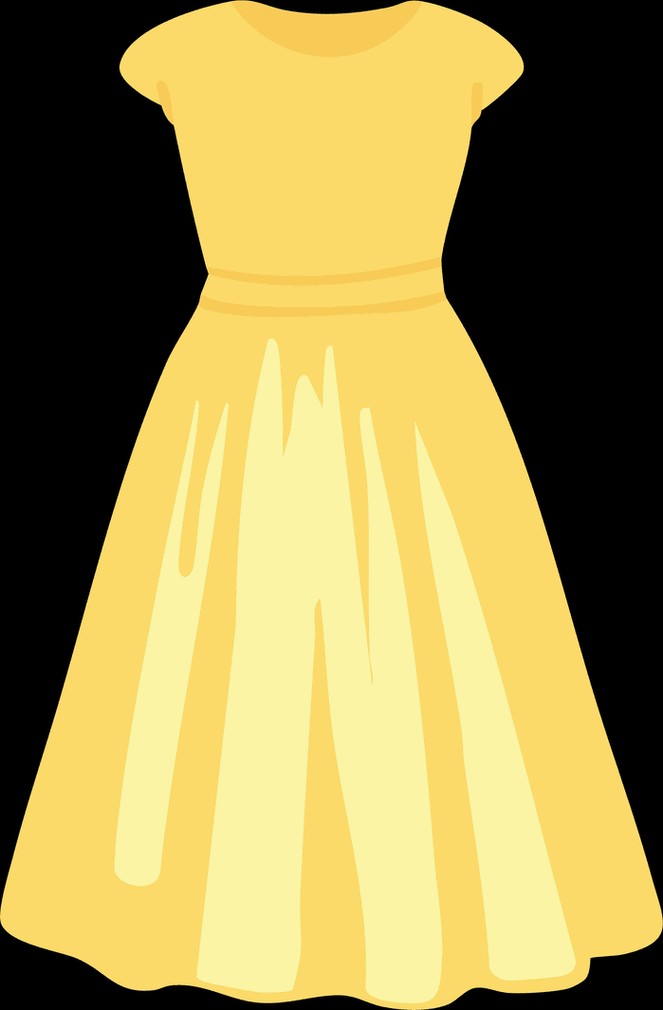

Based on the man's description, what clothing was mentioned that the girl is wearing?
Yellow Shawl
Yellow Sandals
Yellow Dress

Slide 45
I didn't notice when the cab drove away.

Slide 46
She stood on the sidewalk before the gate, hugging her handbag—it was the square reed bag to her body and I could see her plain and whole. It was like the first time I ever saw her and I could hear my booming heart.

Slide 47
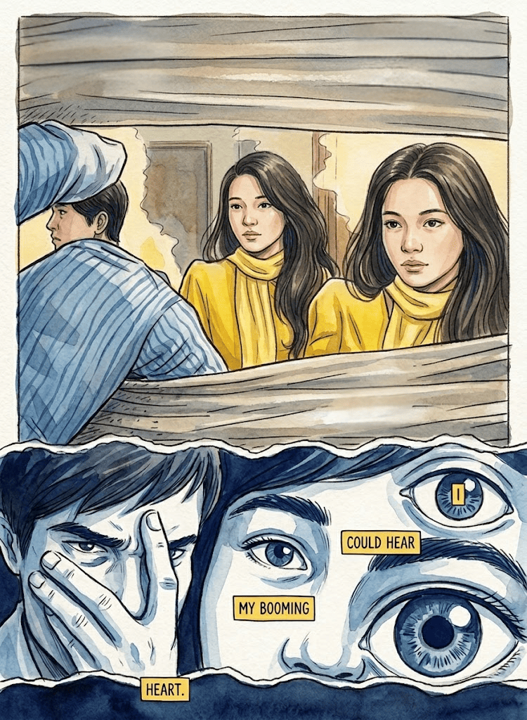
I stepped back, away from the window but only far enough not to be seen. Now I could see her face clearly: I saw her brow and her fine eyes and her fine nose and mouth; I saw her very white throat: how flowerlike her face was, how like a flowerstalk her throat.

Slide 48
moved to the window again when she dropped her eyes. She slipped through the gate, her shawl barely touching either panel. She walked up the concrete driveway. She crossed the lawn and disappeared beneath the green and rust-colored canvas awning of the porte-cochère.

Slide 49
I let the blinds go: now she is going up the steps to the side entrance.

Slide 50
I noticed that I had fallen forward against the window still and that the pale green slats of the blinds were almost against my face: now she is looking at the letter boxes and the name cards and the black buttons and the cutout brass letters.

Slide 51
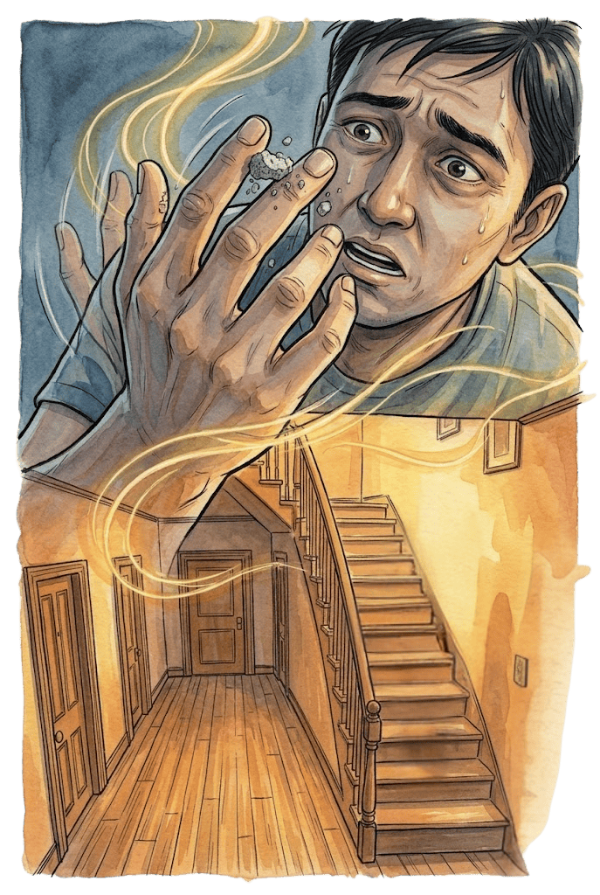
Then I felt my forehead hurting. I had leaned my head too heavily against the sharp concrete edge of the window jamb: now she has found the bell to the apartment.

Slide 52
I pushed myself away from the window, abstractedly I lifted my right hand and rubbed my brow where it hurt: now she is going to ring.

Slide 53
Something had come off my temple to my hand—gritty bits—and I was rolling the stuff absent-mindedly between my thumb and fore and middle fingers; I had lifted my hand and was looking at what I was kneading there when the doorbell rang.

Slide 54
It wasn’t really a bell: they were musical chimes. They were not meant to startle but I startled at their sound. I looked at my thumb and fingers and saw the bits of stucco there: now she is going up the first flight of steps.

Slide 55

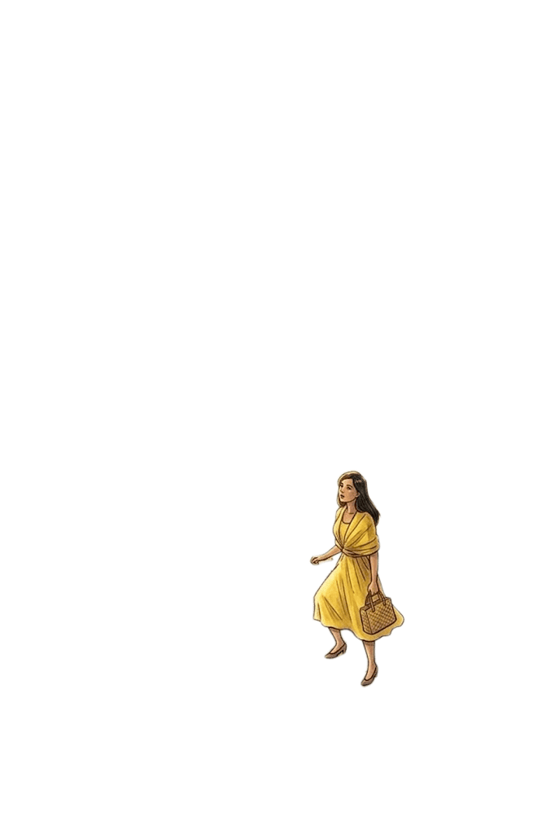
I didn’t know, as I stood, that I was swaying until I saw the stucco in my reeling hand: now she is on the first landing, looking at the cutout brass letters on the doors; she will stop only long enough to know how the apartments are arranged and then she will not stop again.

Slide 56
I reeled away from the window and started weaving up the room: now she is going up one of the second stairs.

Slide 57
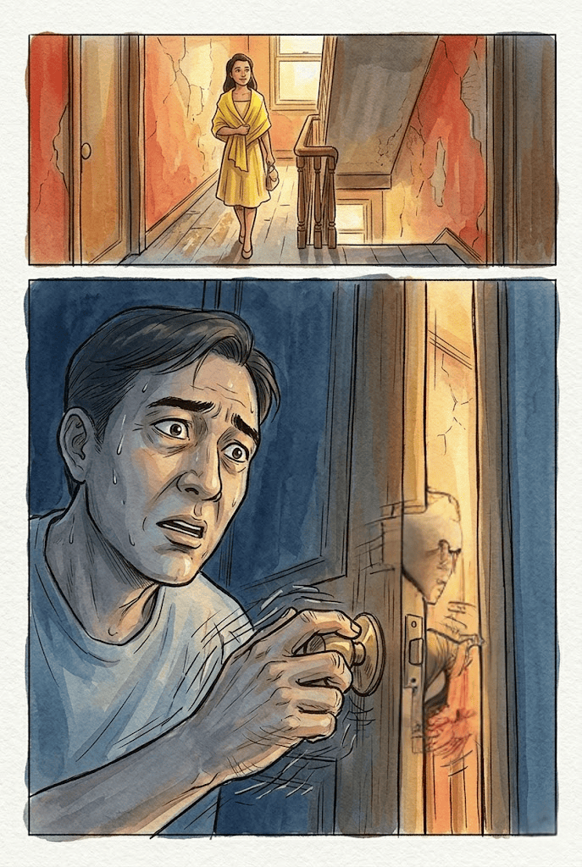
Between the front room and the vestibule I caught at the doorjamb and held myself there with my right hand: now she is on the second landing.

Slide 58
My hand held me trembling to the entranceway: now she is walking up the passageway between the railing and the wall.

Slide 59
It was then I felt the eyes upon me, the eyes watching me; and I began to wheel around.

Slide 60
I looked a long time at the long thin man with the wild wandering eyes and the drawn ruined face before I realized it was my own reflection.

Slide 61
Now she is in the hall outside the door. Now she is at the door.

Slide 62
I lurched into the vestibule and staggered to the apartment door. I broke my precipitate movement by left straight-arming the wall beside the door and catching at the brass door knob with my right hand.

Slide 63
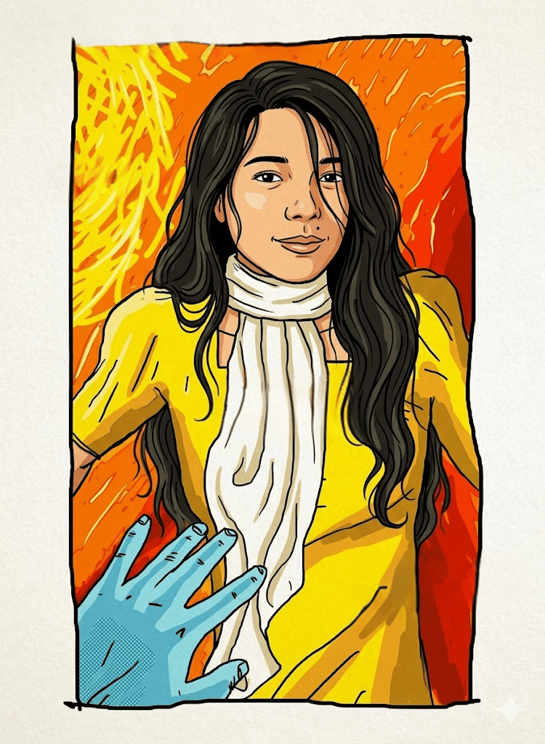
When I pulled the door in, she was there. Now I see you face to face: now I see your small white hands: how flowerlike your face is, how small and flowerlike your hands

Slide 64
She was in the yellow dress with the square neckline and short puffed sleeves. She was smiling; her eyes were bright and shining; and she was humming to herself.

Slide 65
Based on the man's actions and point of view, what do you think the woman’s point of view will show?

Slide 66
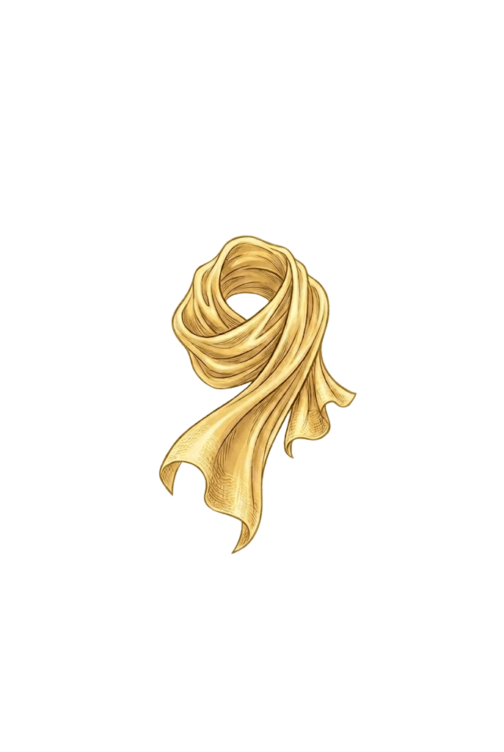
The Girl’s
Story

Slide 67
Are you willing to meet up with your former lover?

Slide 68
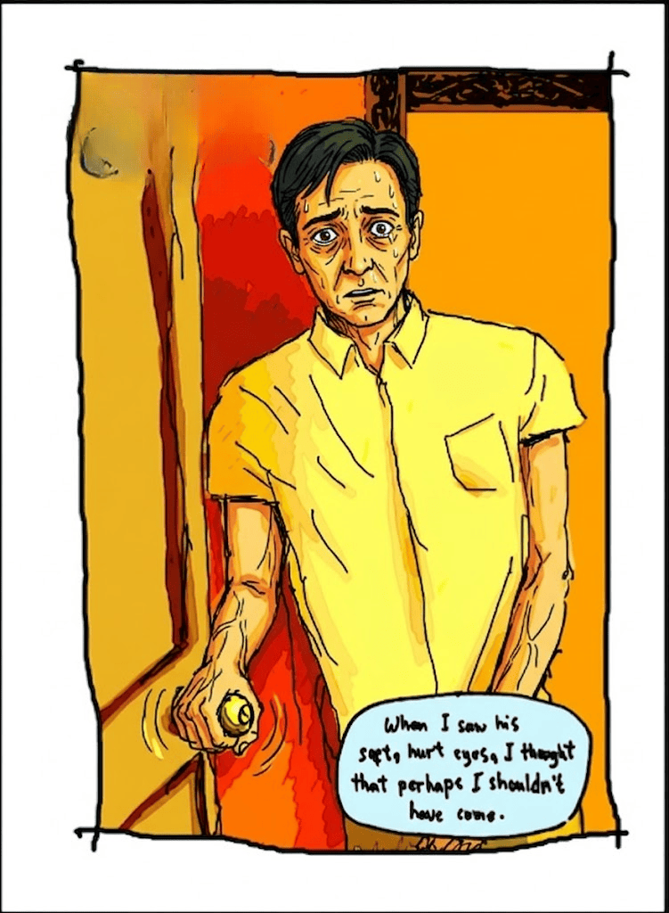
He stood before me, holding the door open, his hands resting upon the doorknob as if he held himself up that way.

Slide 69
When I saw his soft hurt eyes and his pale thin face and his shock of hair, I thought that perhaps I shouldn't have come.

Slide 70

Why do you think the narrator said this, "I thought that perhaps I shouldn't have come"? What does she mean?

Slide 71
He looked at me a long time without saying anything as if he couldn't believe I was there. I said Hello. He didn't answer.

Slide 72
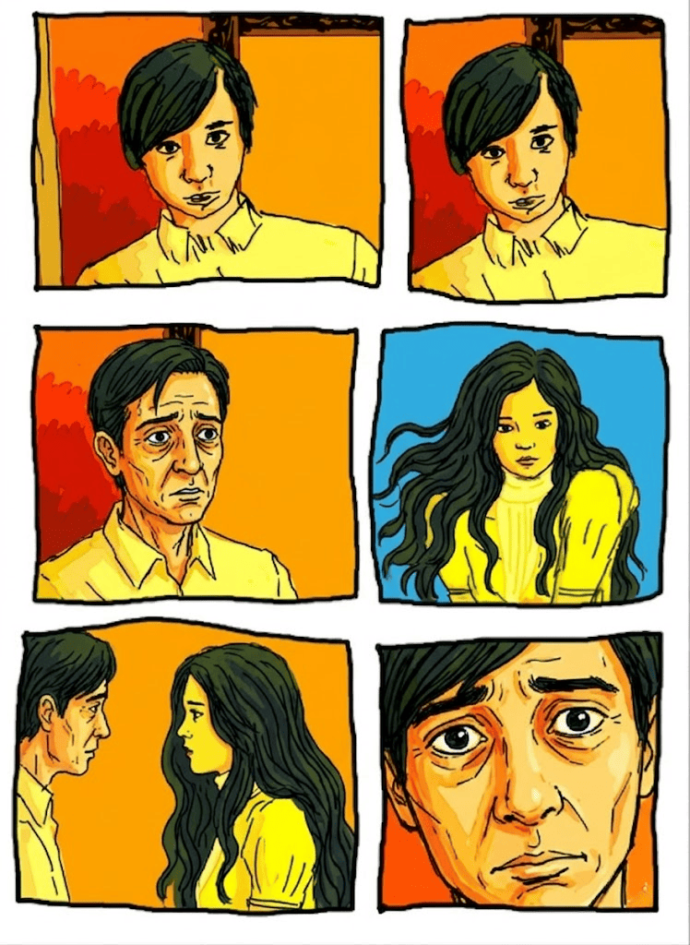
When he spoke, it was to say my name.

Slide 73
Then he stepped aside, away from the doorway. I walked into the small bare anteroom,

Slide 74
I saw the tall wall mirror in the inner room facing the entranceway from the outer room and the apartment door.

Slide 75
I walked to the middle of the anteroom and stood there with my back towards him.

Slide 76
In the mirror I saw how slowly he shut the door after me, leaned back upon it as if he was very tired, slowly lifted his right hand to rub his forehead with his palm and sweep back his uncombed hair with his fingers.

Slide 77
I turned around and faced him when I saw his hurt unguarded hopeless eyes.

Slide 78
He pushed himself forward away from the door and walked towards me in the middle of the anteroom.

Slide 79
The mirror is one of the first things the narrator notices inside the apartment. If a mirror could reveal not your appearance but your emotions, what would it show about you?

Slide 80
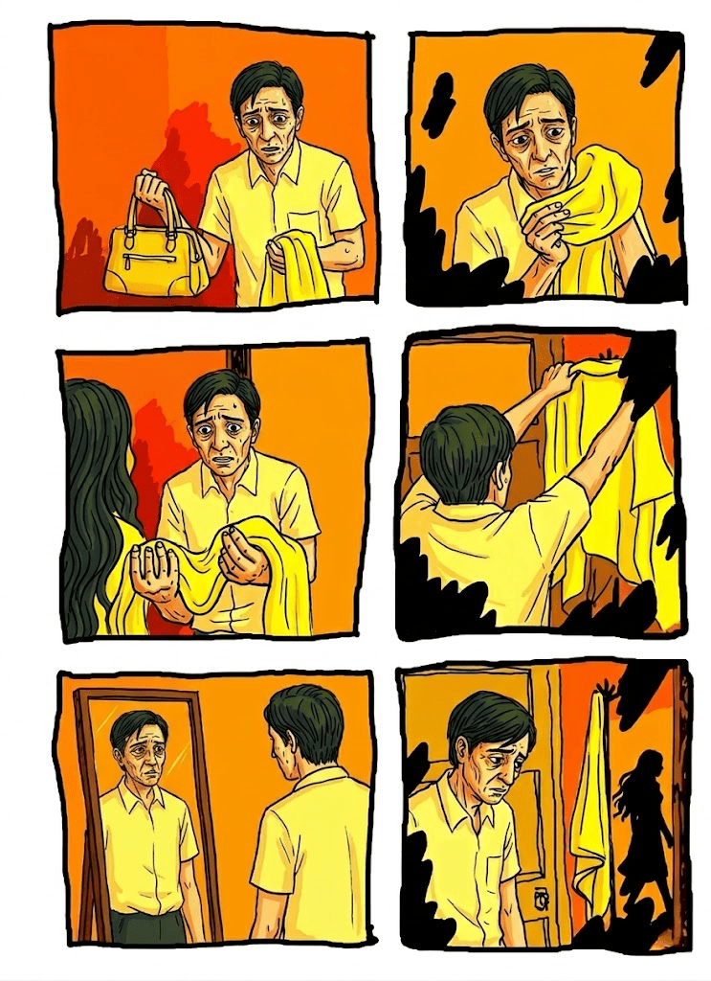
As he passed me, he asked for my handbag and my yellow shawl.

Slide 81
I fell in step beside him and, as we walked to the living room, I slipped the shawl off my shoulders and listened and passed my bag and the shawl to him.

Slide 82
I fell in step beside him and, as we walked to the living room, I slipped the shawl off my shoulders and listened and passed my bag and the shawl to him.

Slide 83
We entered the living room. I saw in the looming mirror how he carried the shawl in one hand held stiffly up before him and the bag in the other which swung listless by his side.

Slide 84
He stopped as soon as we crossed the doorway.

Slide 85
I walked on to the middle of the room and stood before the mirror with my back towards him.

Slide 86
In the mirror I saw him place the bag on top of a wall table beside the doorway and then raise his arms and very carefully drape the shawl so it wouldn't rumple over the topmost arm of the coatstand to one side of the doorway beside the wall table.

Slide 87
I turned around and faced him as he walked towards me in the middle of the long room. He stood before the mirror, and asked me to sit down.

Slide 88
I sat down and told him that I couldn't stay very long.

Slide 89
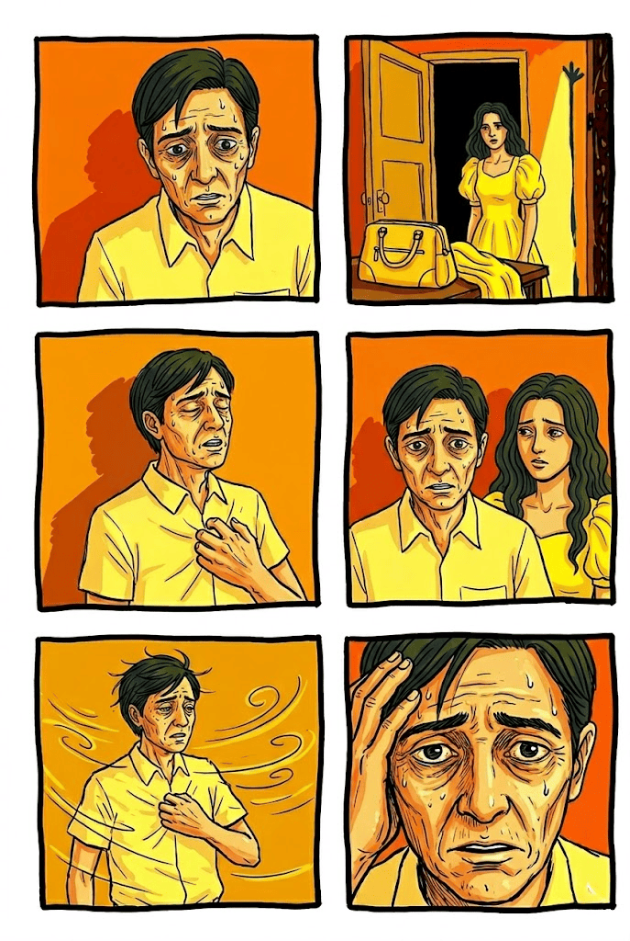
He stood before me, behind him loomed the mirror. In the mirror shore him I could see the reflection of my yellow shawl.

Slide 90
“Yes, of course," he said.

Slide 91
If you were the man, how might you feel hearing “I couldn’t stay very long” after waiting for someone’s visit?

Slide 92
Then he began to speak, he walked as he talked, his words sprang from his mouth like birds. He swung his arms; they beat like wings.

Slide 93
He paced up and down the long room from the window to the back room door and I followed him with my eyes.

Slide 94
Why does the woman compare the man’s words to birds and his arms to wings?

Slide 95
He stopped at the door into the backroom and stood there: then he turned and, looking at me, said:

Slide 96
"I can't get you out of my heart any more: I can't unlove you."

Slide 97
The man admits that he cannot stop loving someone he cannot have.
Why do you think some feelings remain even when we know they cannot be fulfilled?

Slide 98
He walked down the long room and, as he crossed between me and the mirror and I saw in the mirror the reflection of the shawl spread like a wing above him, he said: "You are all the girls I have ever loved."

Slide 99
He stopped at the window and stood there. A breeze was blowing, the pale green blinds very near his face were beginning to stir. He walked up the long room and as he crossed between me and the mirror and I saw the shawl spread above him like a wing, he said:

Slide 100
"Marriages are made in heaven. Marriages are made in hell. This is one marriage that shall never be, on earth, in heaven or in hell."

Slide 101
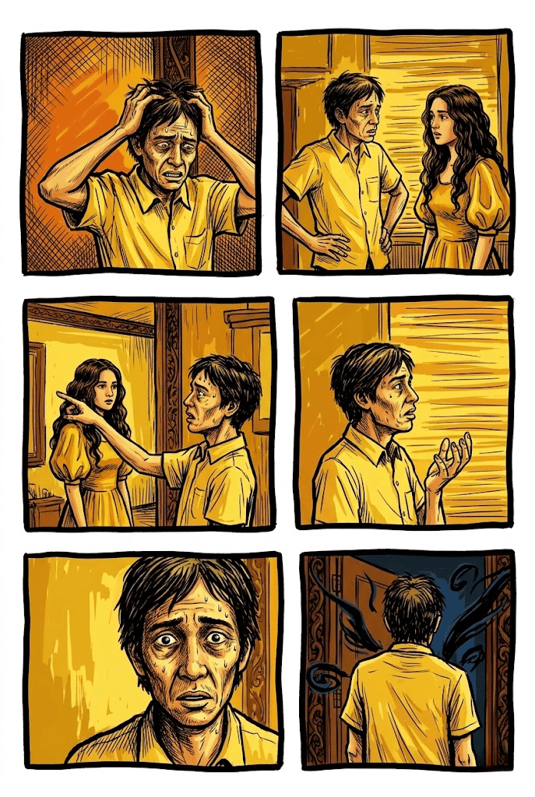
He walked down the long room and as he crossed between me and the mirror I saw the shawl like a wing spread above him, he said: "It is like knocking on a door that shall never open. It is like storming a wall that shall never fall."

Slide 102
The man says, "Marriages are made in heaven. Marriages are made in hell." What idea is he emphasizing?
A. Marriage is always unpredictable.
B. Marriage can bring both joy and suffering.
C. Marriage depends entirely on fate.
D. Marriage often begins with conflict.
B. Marriage can bring both joy and suffering.

Slide 103
He stopped at the window and stood there. He lifted his face as if to smell the sea, as if to listen to the sea. The pale green blinds almost against his eyes were rustling in the evening wind that was blowing from the sea laden with sea-scent and sea-sound.

Slide 104
Then he turned and, looking at me, said: "I lost you even before I found you."

Slide 105
He was crossing between me and the mirror when he stopped, turned to me and stood before me, between me and the mirror. d and, looking at me, said: "I lost you even before I found you."

Slide 106
I was looking up at him and I was looking at his reflection in the mirror too and I saw him as he was as he stood rocking before me, and I saw him wa his reflection also in the mirror that loomed large behind him when he said:

Slide 107
“I might as well live as I might as well die."
Then he turned away from me.
I saw his face as he turned away, I saw in the mirror the reflection of his face as he turned towards the mirror, I saw his tortured twisted face.

Slide 108
What is the emotional effect of the man saying, “I might as well live as I might as well die” from the narrator’s point of view?

Slide 109
“I saw in the mirror the yellow shawl hovering above him, I saw the yellow wing brooding over him.
Then the wing began to beat and to churn the air.

Slide 110
“Then the wing lifted, leaving the air clear and shaken, filled with a yellow light.

Slide 111
Why might the author repeatedly place the man in front of the mirror during his emotional confessions?

Slide 112
Suddenly it wasn't early evening any more but deep night. It wasn't now but nine years back.

Slide 113
It wasn't an apartment on Indiana Street but the Japanese garrison halfway between Valencia and Garcia Hernandez

Slide 114
It wasn't he who stood rocking beneath the yellow shawl before me but my father.

Slide 115
And the yellow shawl that beat above him like a wing was not mine any more but my mother's.

Slide 116
What does the yellow shawl most strongly symbolize in the passage?

Slide 117
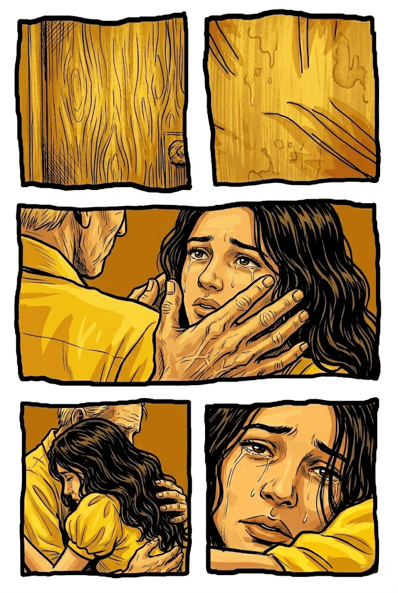
I raised my hands and jammed the heels of my palms against my ears. But I heard again and couldn't shut out my mother's screams and my father's anguished cry.

Slide 118
He sat on his heels before me, wavering. His hands were on my shaking shoulders. His face, suffering and startled, was very near my eyes: it was clear and blurred by turns.

Slide 119
I didn’t know that I was crying until I heard what he was saying over and over again.

Slide 120
“Please don't cry," he said. "How I love you! Don't-don't cry." But I couldn’t stop crying.

Slide 121
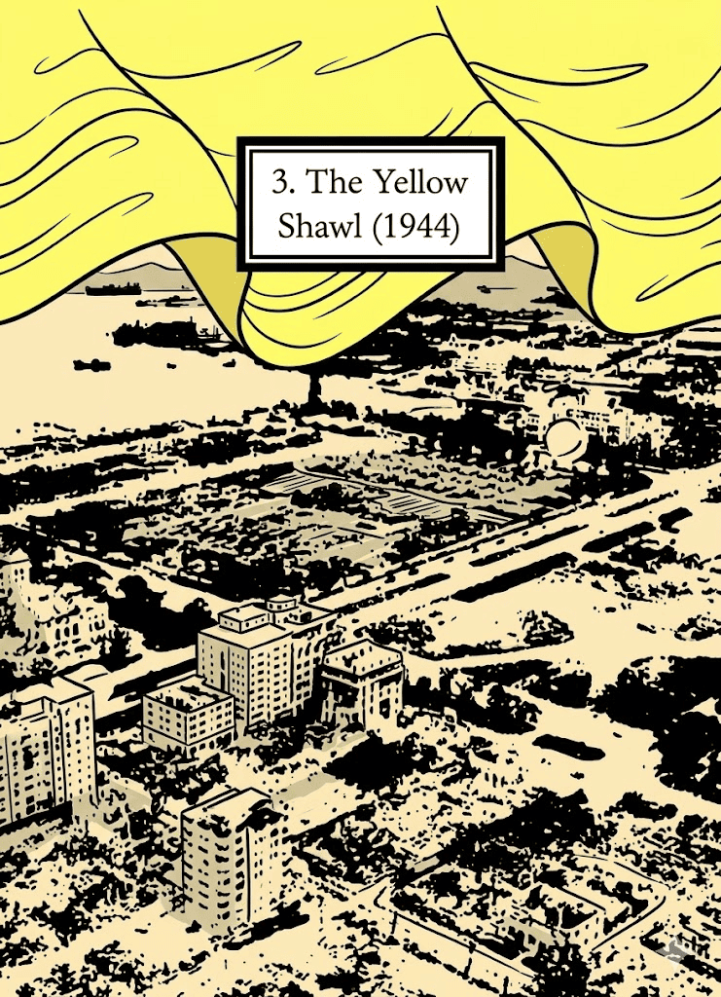
The Girl’s
Story

Slide 122
What childhood experience would you want to experience again?

Slide 123
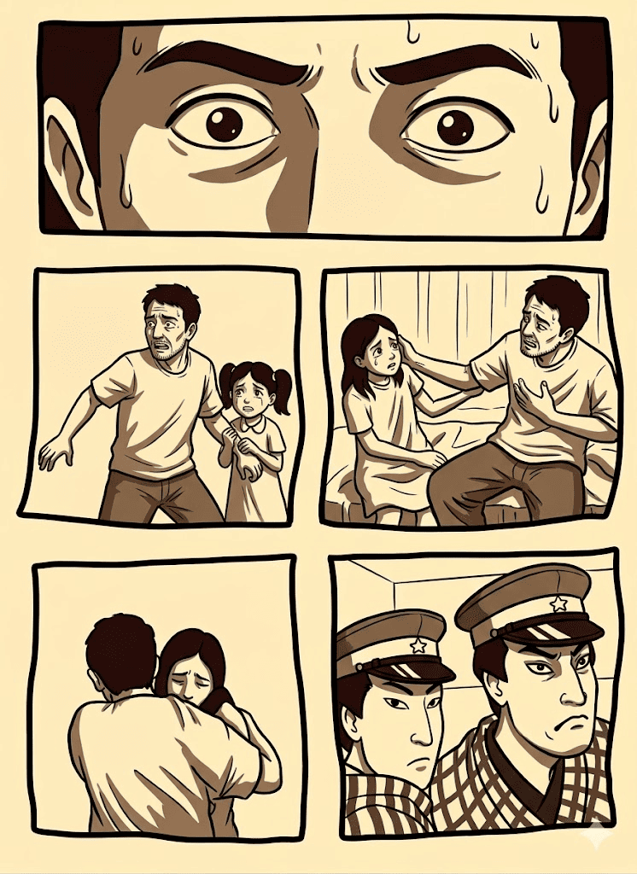
The child woke up when her father lifted her from the bed. She knew it wasn't morning yet because the lights were on and they were very light. She was already ten and she didn't like being carried anymore, not even by her father.

Slide 124
She was already ten and she didn't like being carried anymore, not even by her father. She tried to wiggle loose from her father's arms but found that she couldn't. She saw that she had been bundled up in bedclothes.

Slide 125
She was turning in her father's arms to ask him where they were going when she saw the many silent Japanese.

Slide 127
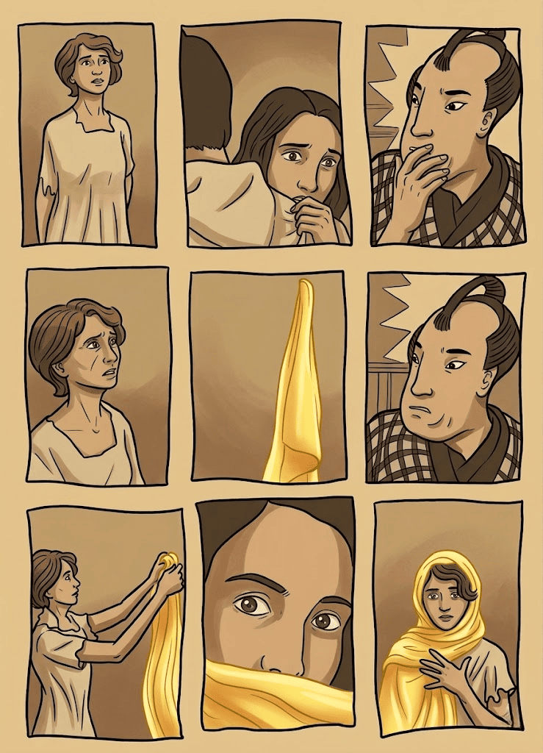
She couldn't ask any more. Then she saw her mother: how pale she was, and distraught. Her father told her to go to sleep right in his arms. She tried to but couldn't.

Slide 128

Based on the POV exposition, which country might be invading the country?

Slide 129
The Japanese said: Come. At the door, her mother saw the lovely vivid yellow shawl and her mother asked the Japanese if she might not take it along with her.

Slide 130
The Japanese said: All right. Her mother wrapped the shawl about her; the night was cold, the air struck at her face where it was exposed.

Slide 131
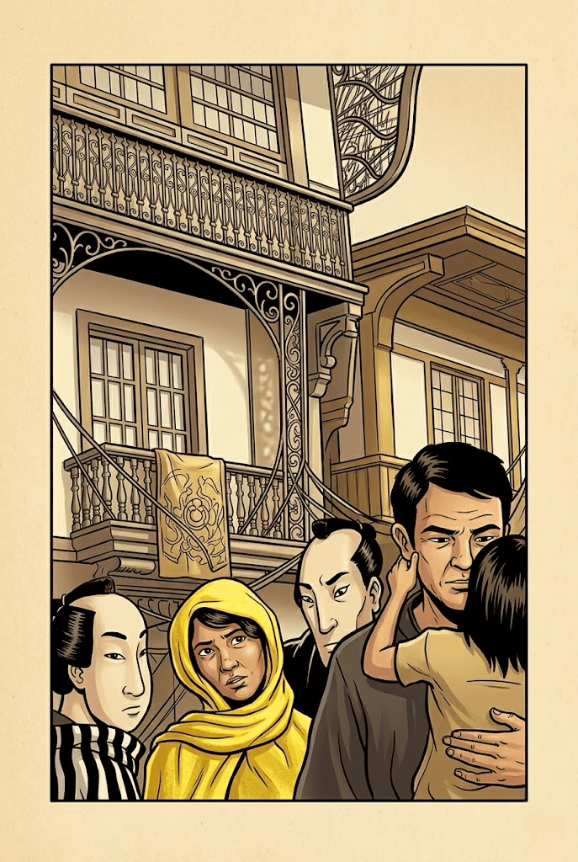
It became even harder to try to get to sleep. She watched the many silent Japanese from her father's shoulder.

Slide 132
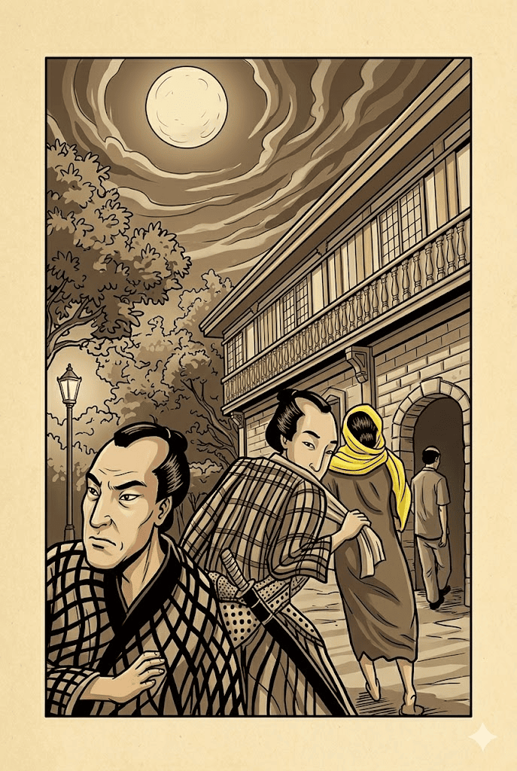
They walked a long time; they reached a big house. The Japanese took them to a large room and left them there. In the room it was very bright; it was also very bare.

Slide 133
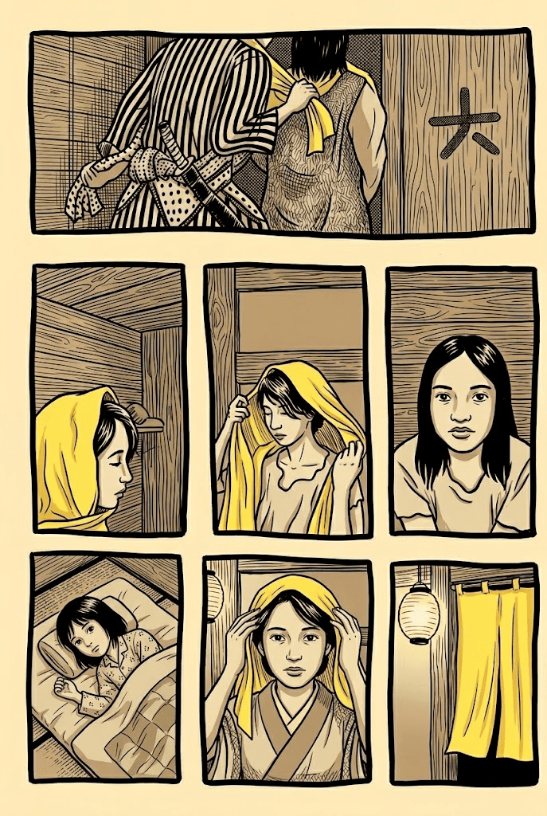
She watched her mother walk around the enormous room. Her mother stopped beside the door and stood on tiptoe and reached up with her arms to hang the shawl from a peg high up on the wall.

Slide 134
Then she tried looking without blinking at the big bulb hanging by a cord from the roof. Her eyes hurt. She tried to sleep but couldn't sleep.

Slide 135
She told her father, then her mother, that she couldn't sleep. They sat on the cot beside her to lull her to sleep. The light was too bright; the room was big and strange.

Slide 136
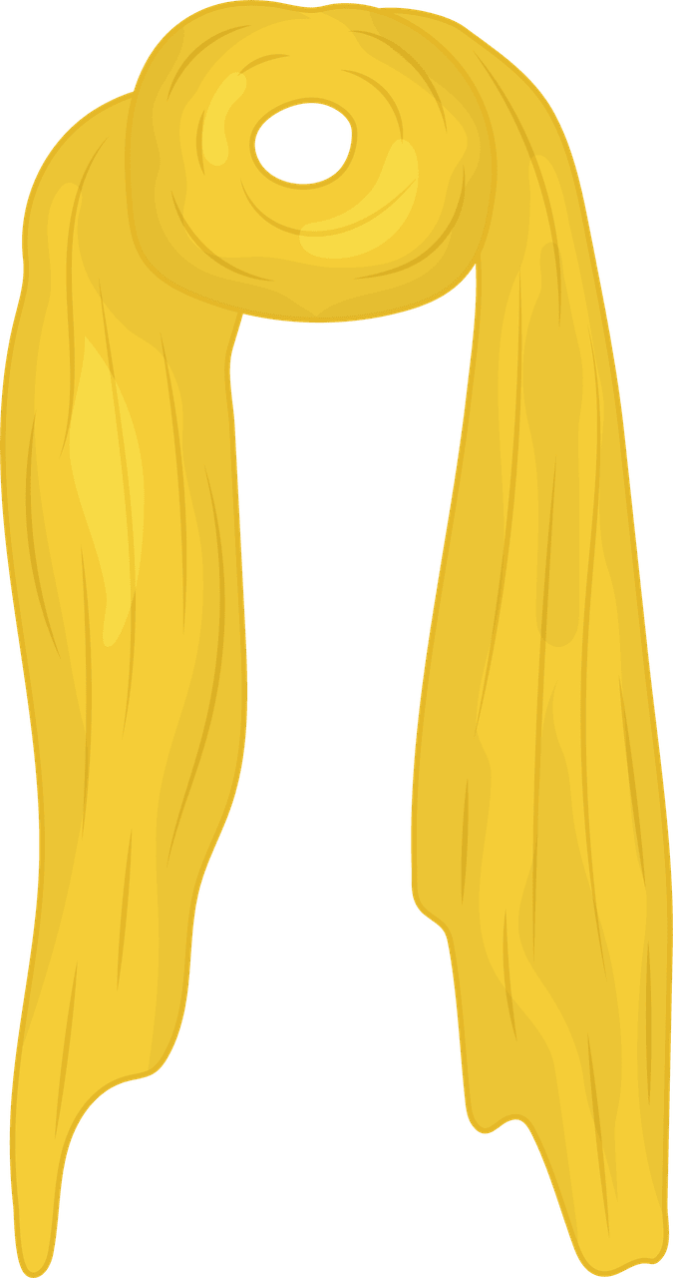


What object appears repeatedly in the three points of view in the short story?

Slide 137
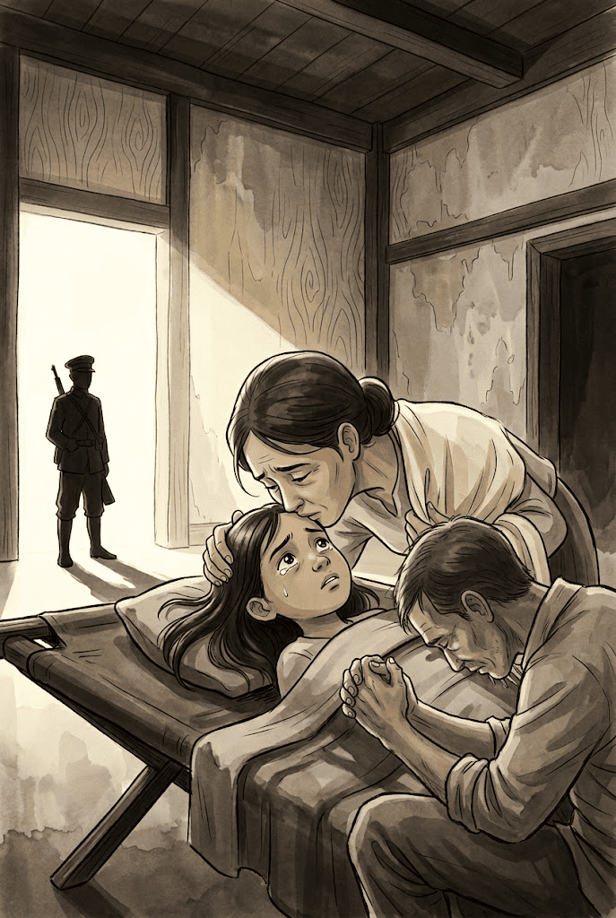
Then the Japanese returned. Her mother stood up, stooped and kissed her, told her to be a good girl and sleep; and left with the Japanese.

Slide 138
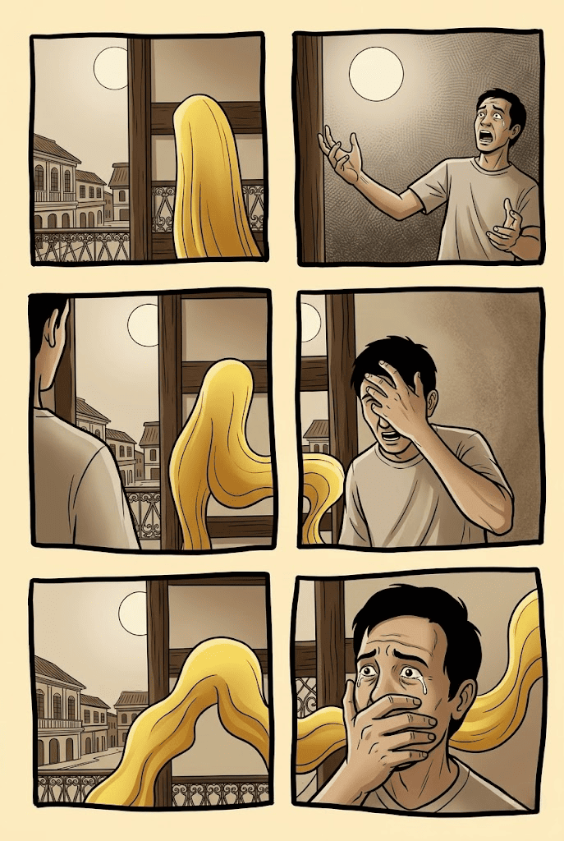
She looked at the shawl on the peg high up on the wall beside the shut door. Then her father told her to go to sleep.

Slide 139
She heard her mother scream. It was so loud she thought her mother was back in the room with them.

Slide 141
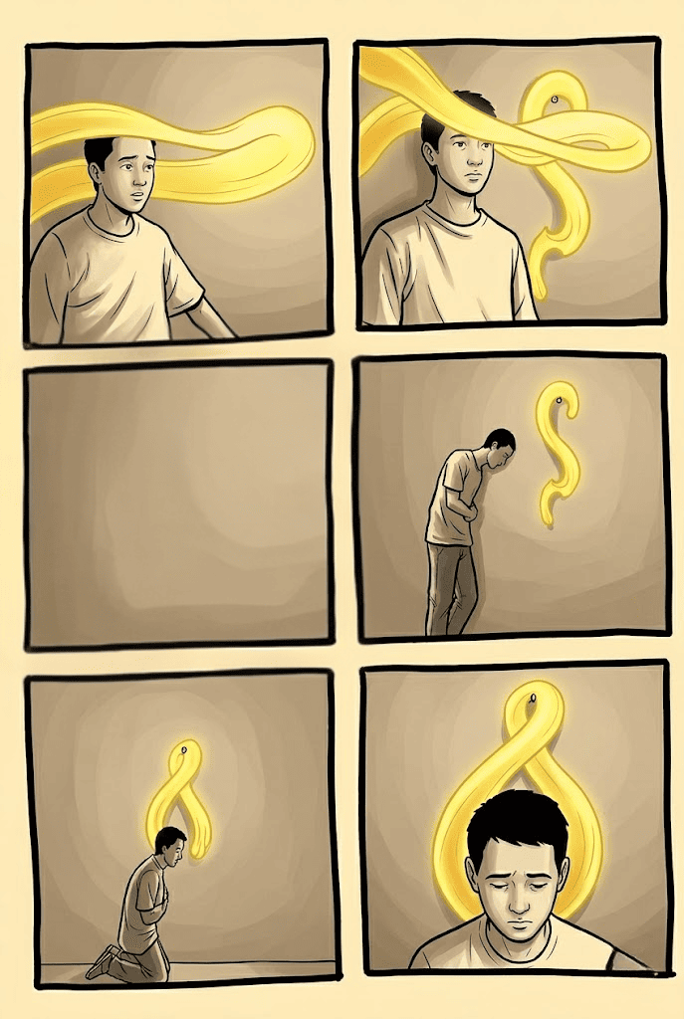
Suddenly her father was no longer beside her but was pacing up and down the middle of the wam from the window to the wall.

Slide 142
Every time her father crossed the room she saw how the shawl beat like a wing in the garish light above his head.

Slide 143
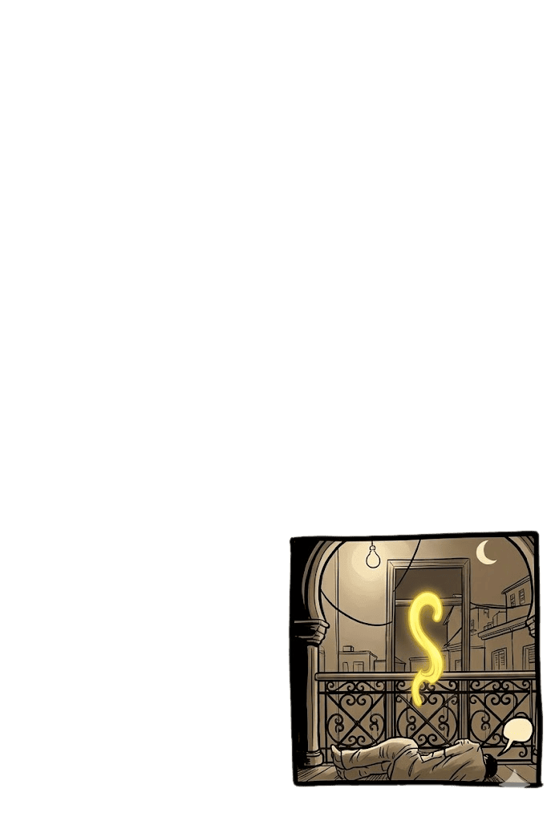
Her mother screamed again and her father, released, lurched up and down the enormous room again.

Slide 144
The screams came and went, grew fainter and fainter, and then the child couldn't hear them any more.

Slide 145
Her father stood beneath the shawl that brooded like a wing over him, still tense and waiting, but the screams didn't come again.

Slide 146
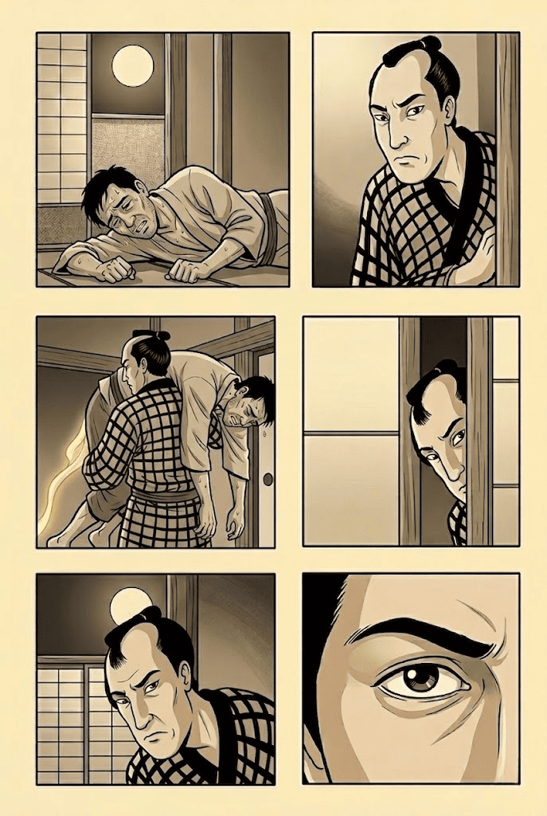
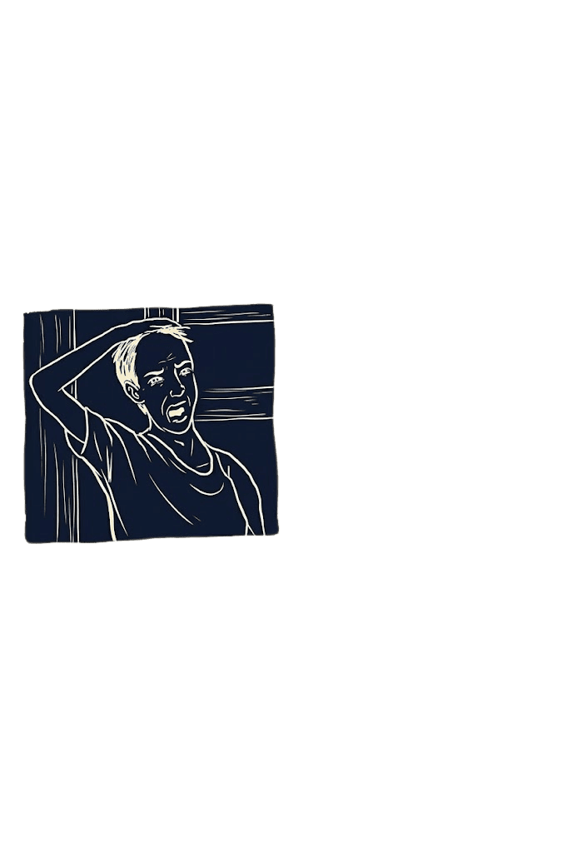
She saw her father sway and rock; she saw his incredibly coherent face break and crumble.
The child didn't even start at the sound of the animal cry that tore savagely through her father's body and his throat.

Slide 147
She watched her father fold and fall. She heard him whimper.

Slide 148
Her eyes were wild and wide upon her father's body,

Slide 149
She felt very wide awake. Her sleepless eyes hurt and felt very dry.

Slide 150
What is the reason why the father collapsed?

Slide 151
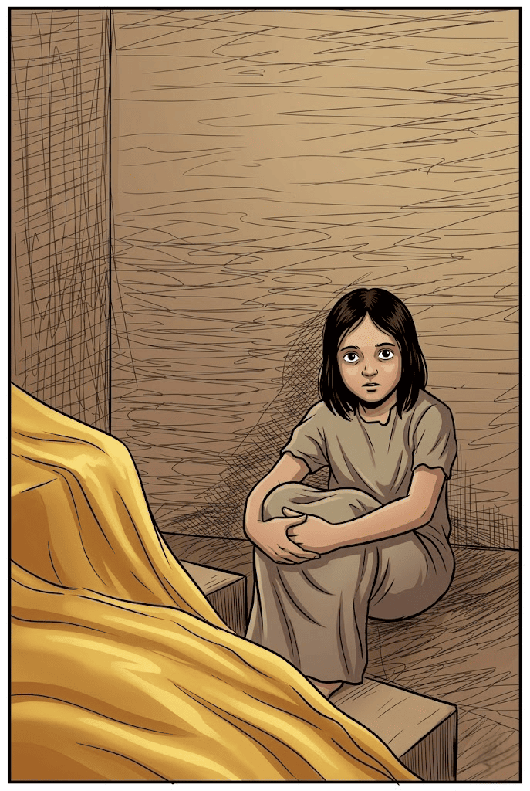
She blinked her wakeful eyes long and hard many times trying to make the tears come but the tears wouldn't come no matter how hard and how long she tried.

Slide 152
f
rancisco "Franz" Arcellana was born in 1916 in Santa Cruz, Manila, the fourth of eighteen children. After studying philosophy at the University of the Philippines, he worked briefly as a journalist before becoming a teacher and writer of fiction. Collections of his work include Selected Stories (1962), Fifteen Stories: Storymaster 5 (1973) and The Francisco Arcellana Sampler (1990). His stories have been translated into several languages. In 1990 he was declared a National Artist for Literature by President Corazon Aquino. He lives with his wife in Diliman, Quezon City, in the Philippines.

Slide 153

Earned 2nd prize at the Philippines Free Press literary contest in 1953.

