Slide 1

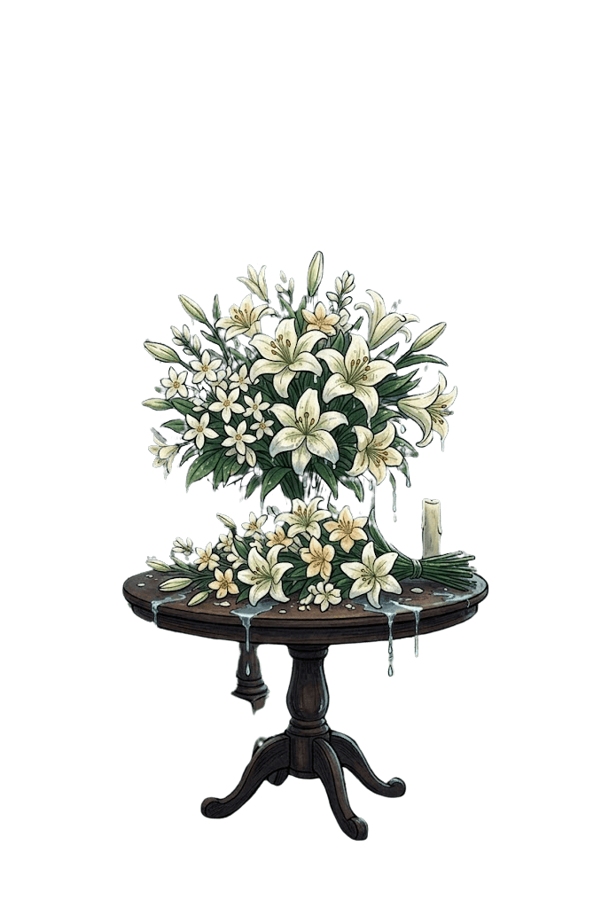

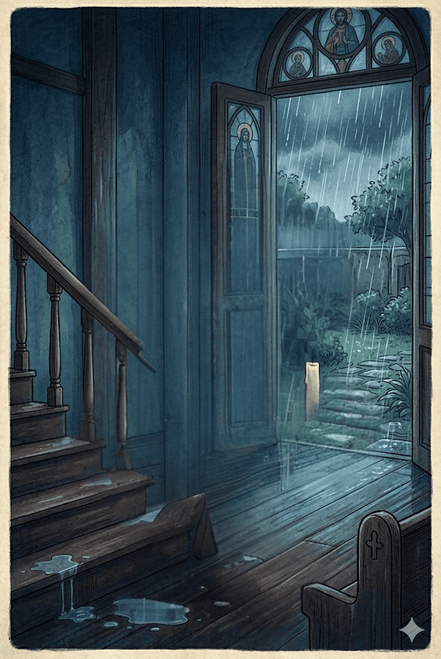

Slide 2
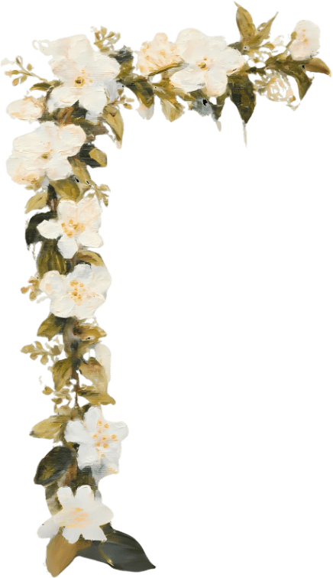

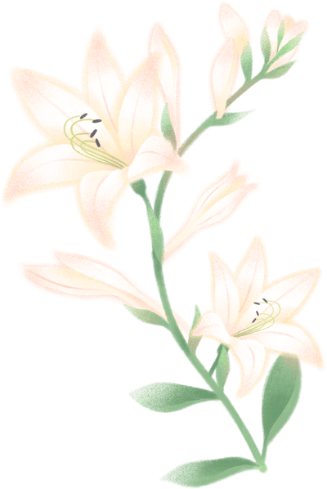
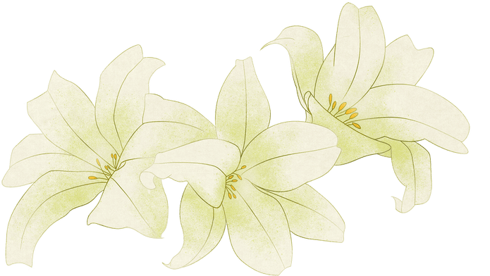
O
bjectives
At the end of the discussion, learners are expected to:
  Explain how symbols, characters, and events in the short story, “The Flowers of May,” contributed to its themes;
  Express meaningful interpretations and personal reflections on textual details and symbols presented in the story;
  Demonstrate sensitivity toward the emotional struggles and sacrifices experienced by characters; and
  Observe how Arcellana’s portrayal of Filipino experiences, family relationships, and enduring love reflects important human values and realities.

Slide 3

THE FLOWERS OF MAY
A
Francisco Arcellana
poignant and haunting tale of grief, memory, and finality.
In the warm, rain-soaked afternoons of May, a family in Tondo prepares for the Flores de Mayo. The heavy scent of wet sampaguita and white lilies, intended to receive the imprint of the Blessed Virgin's feet, instead brings forth the deep, unspoken grief of a father.
Two months after the passing of young Victoria, the floral festival becomes a place of painful remembering, a final acceptance of a love that didn't want to die.
Francisco Arcellana's masterful story unfolds with the crushing weight of beautiful, fallen petals.

Slide 4
THE FLOWERS OF MAY
A
Francisco Arcellana
s you read and explore The Flowers of May by Francisco Arcellana, your group will travel through different locations on a map to gather flowers for a home-based altar in preparation for the Alay or Flores de Mayo celebration.

Slide 5
THE FLOWERS OF MAY
Francisco Arcellana
Mechanics:
  Follow the Story Map. Visit the six designated locations in sequence:
    Home
    Church
    Gumamela Bush
    Ilang-Ilang Tree
    Lily Field
    Home-Based Altar
  At each location, your group will encounter a question, task, or challenge based on the assigned part of the story.
  Every correct answer or successfully completed task earns a flower associated with the month of May.
  Each flower has a corresponding point value, which will only be revealed when the challenge appears.

Slide 6
THE FLOWERS OF MAY
Francisco Arcellana
Mechanics:
  After completing all six locations, arrange your collected flowers into a bouquet.
  Write the name of a person you cherish, treasure, or appreciate.
  Attach a brief dedication explaining why you are offering the bouquet to them.
Winning the Journey
  The group with the highest total flower points will be recognized as the Hermana Mayor 2026

Slide 7
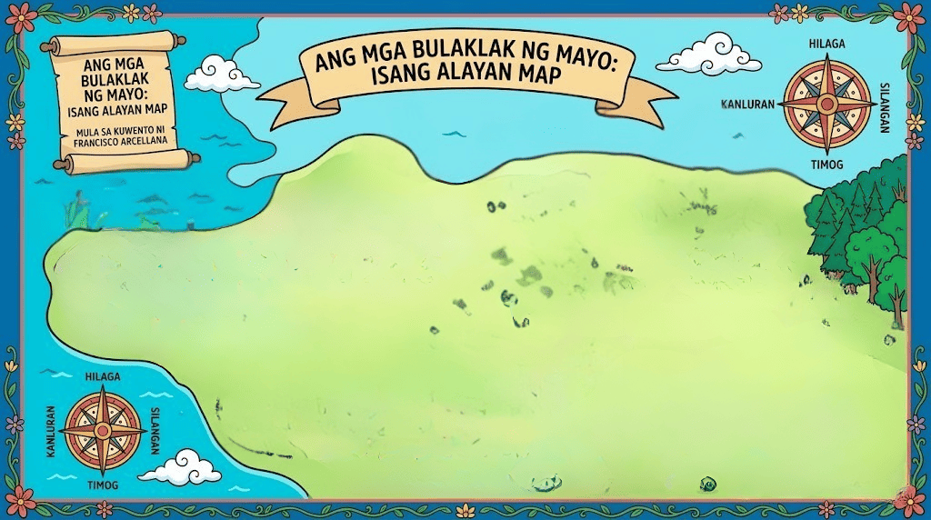


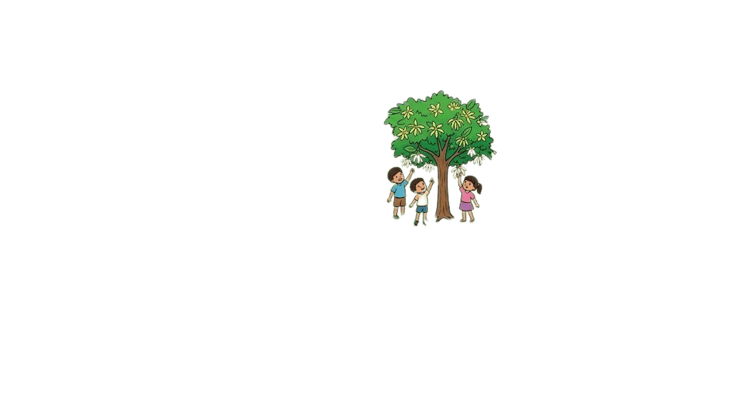

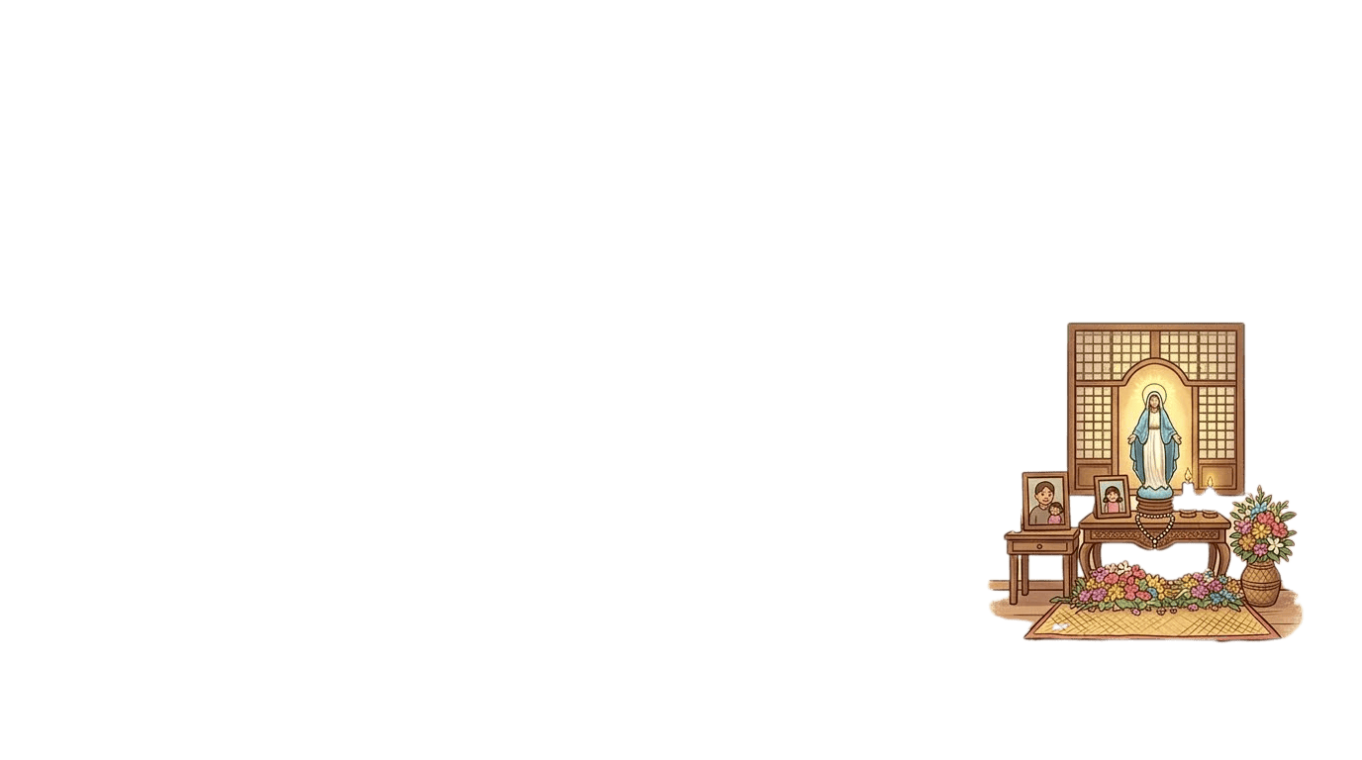
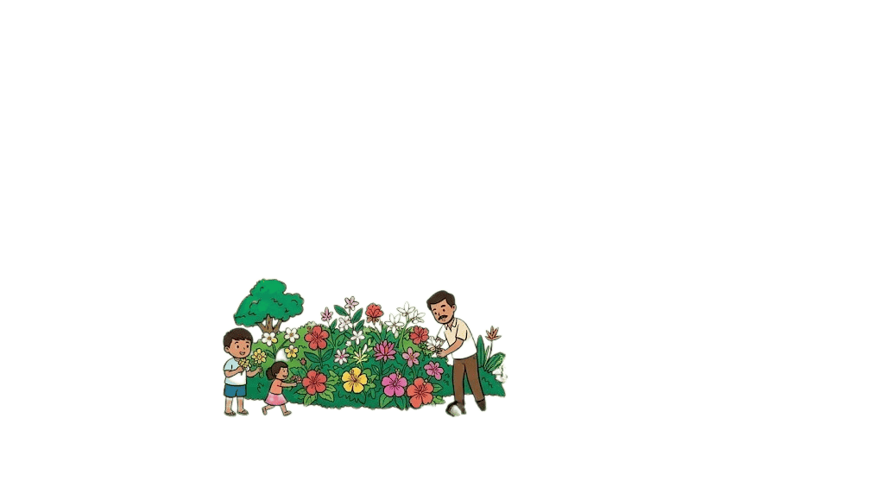

Slide 8
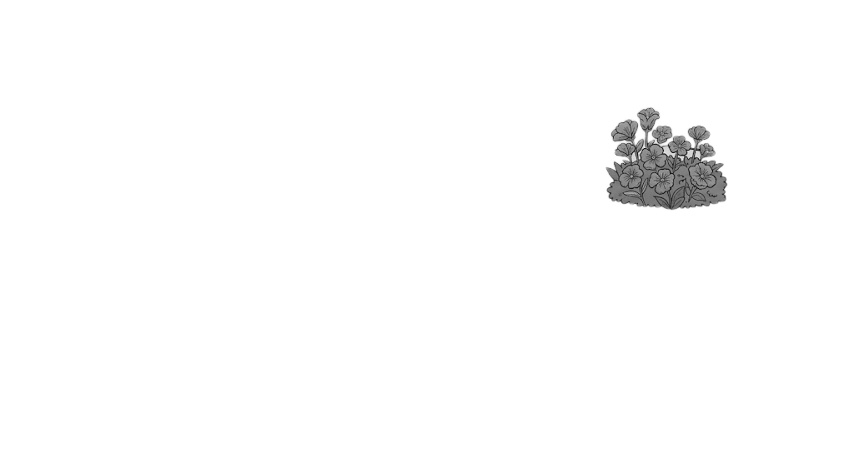

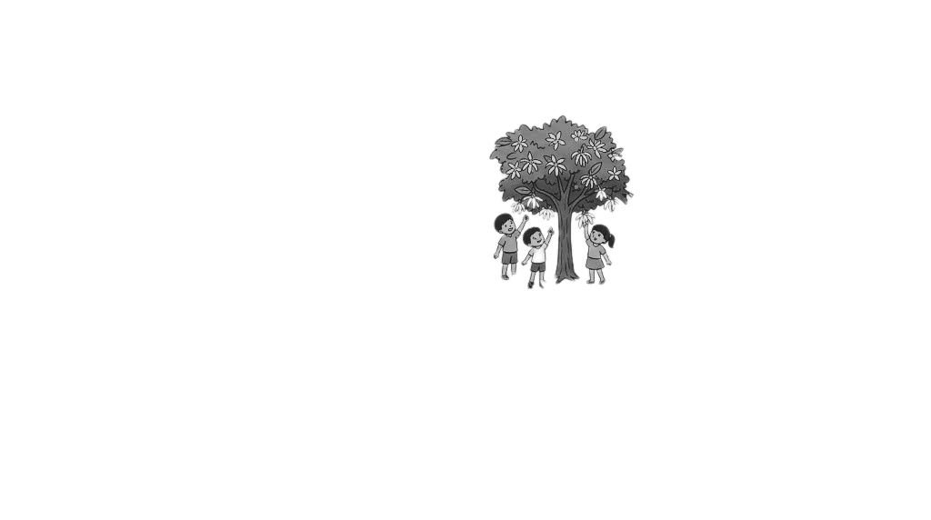
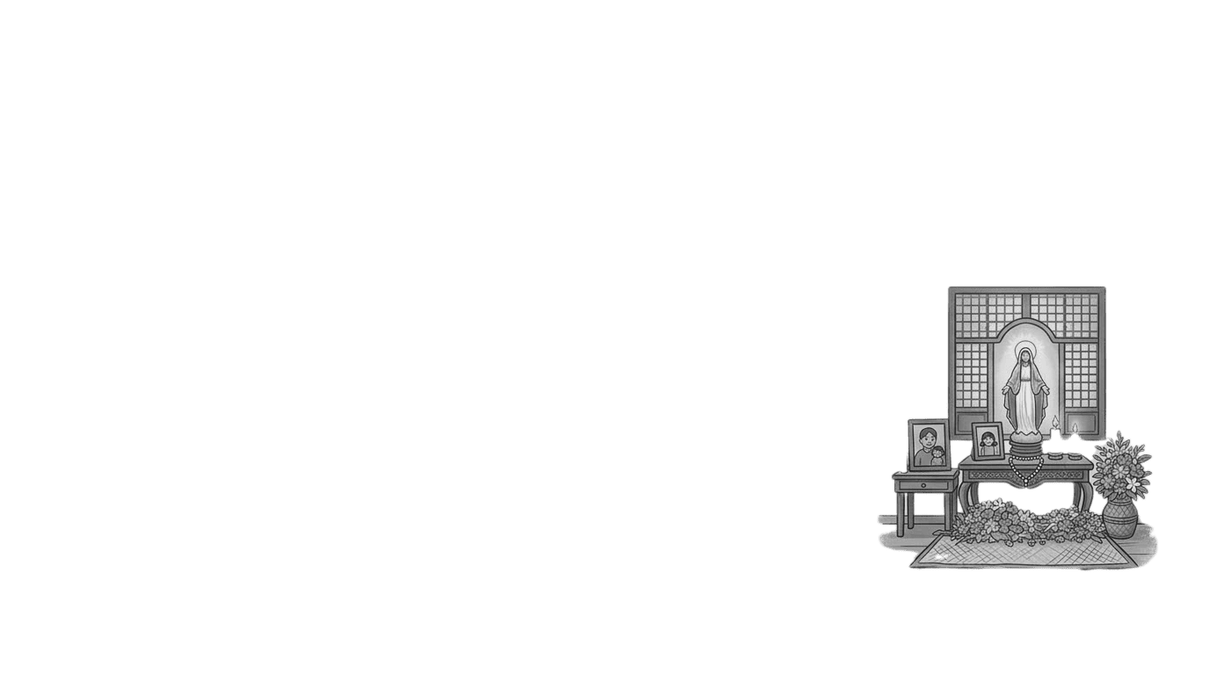
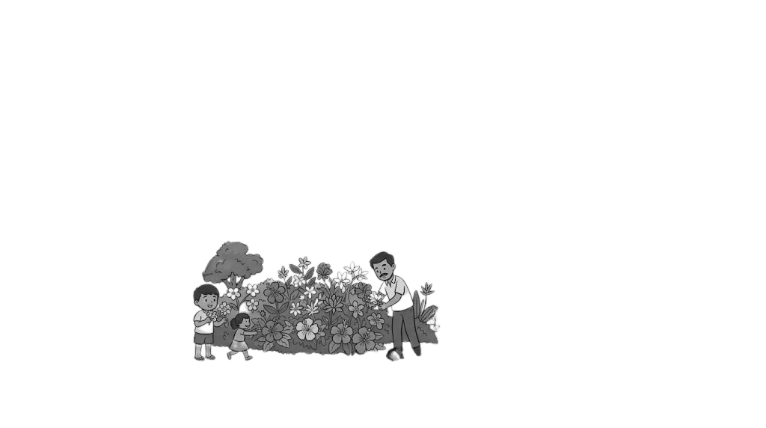

Slide 10

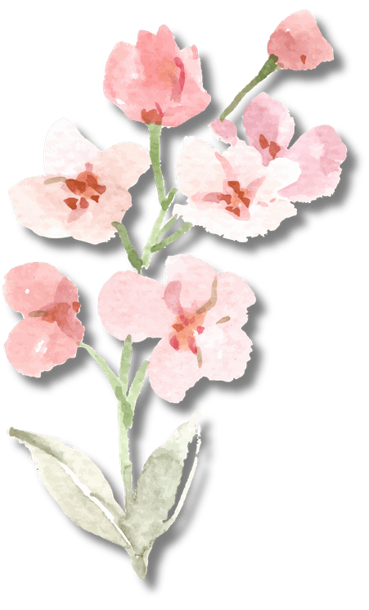
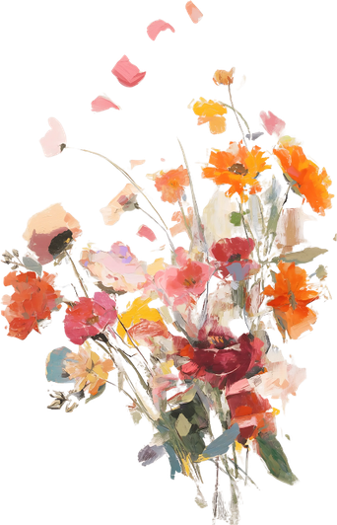
W
hat comes to your mind or what do you feel when the month of May appears and starts?
2 points

Slide 11
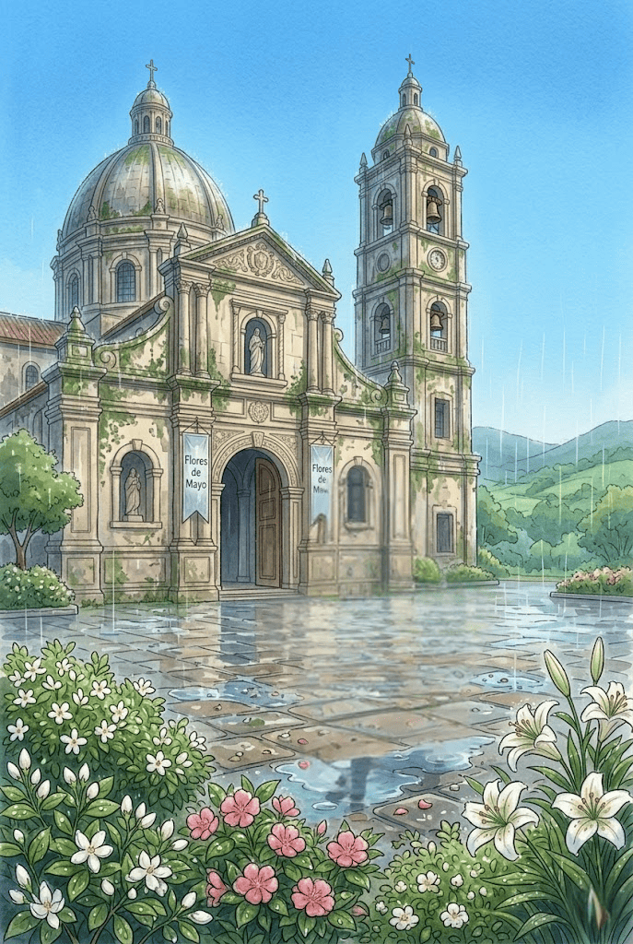
I
T IS MAY again. It is still generally sultry but it has begun to rain in the afternoons and the evenings are clear, the skies are of the utmost blue: new grass is breaking from the earth everywhere.
It is especially pleasant in the afternoons after the rain. The air is clear and fragrant, the sky has a new washed look, and everything looks clean and newborn.
Maytime makes me think of rain and flowers. It makes me think of my father and mother, my brothers and sisters, the living and the dead. It makes me think of churches and how it is inside churches on May afternoons.

Slide 12
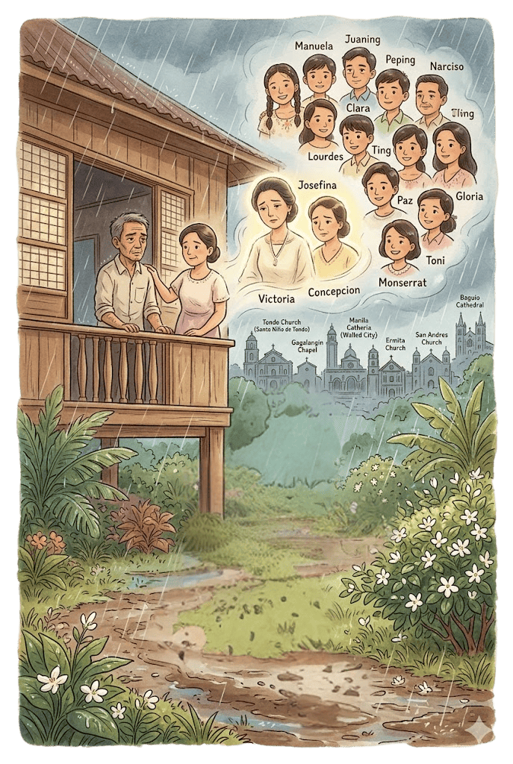
Maytime is running in the rain and gathering sampaguita buds. It is Father standing by the window, watching the rain, his grief for the dead Victoria deep and unspoken; and it is Mother too standing beside Father, trying to share and understand that grief. It is Manuela and Juaning and the dead Victoria and Peping and Narciso and Clara and Ting and Lourdes and Paz and Gloria and Monserrat and Toni and even the dead Josefina and the dead Concepcion whom I did not know. It is the church in Tondo and the chapel in Gagalangin and the churches in the Walled City and the churches in Ermita and Malate and San Andres and Baguio and all the places that I have ever been.

Slide 13
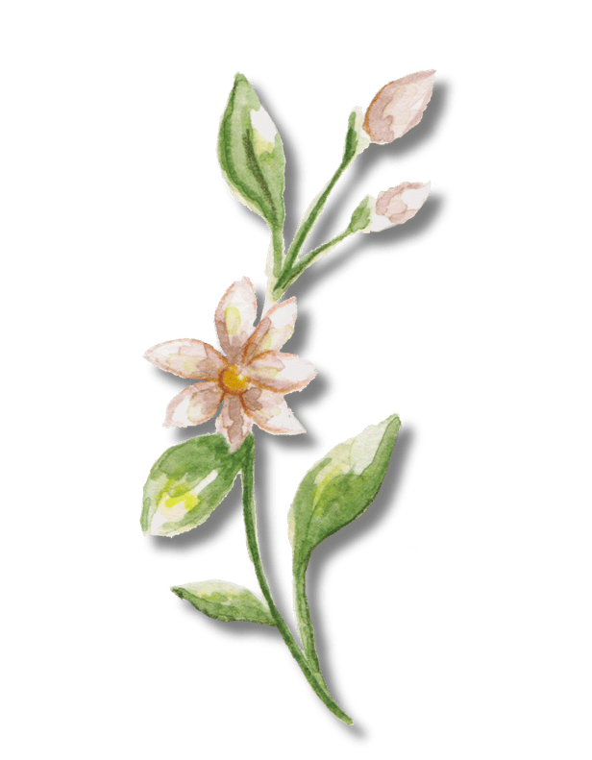
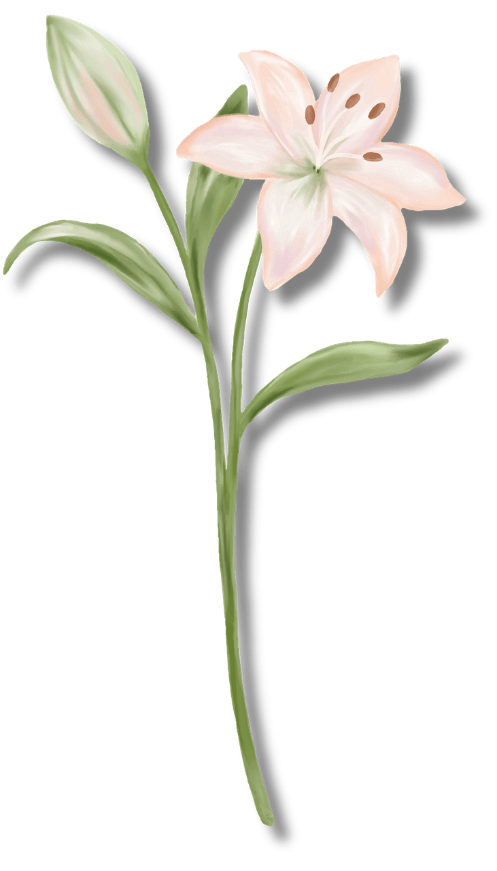


S
elect a flower!

Slide 16
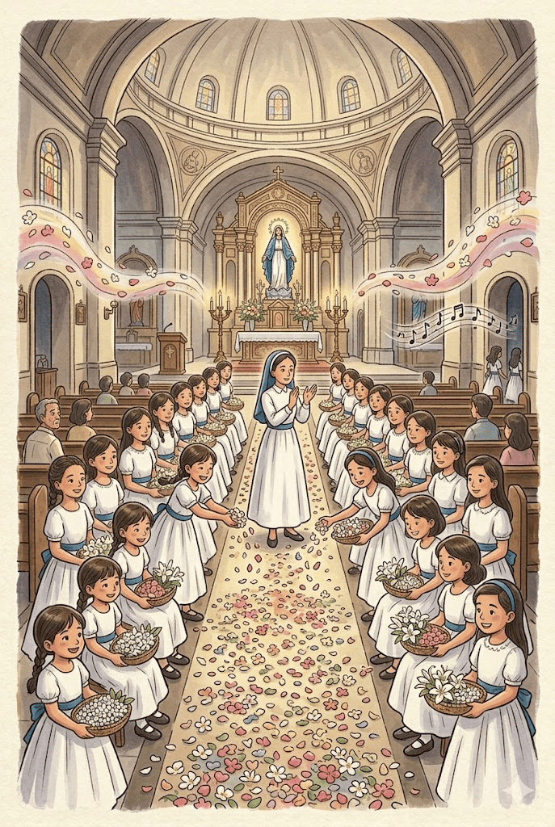
This is how it is inside churches in the afternoons in May: there are girls all dressed in white. They wear blue girdles. They stand or sit in chairs arranged in two rows beneath the church dome in front of the altar.
The smallest are in front and the tallest bring up the rear. They have reed mas filled with flowers: sampaguitas, camias, lilies, plenty of lilies; all the flowers of May. They pray and sing. A woman in white wearing a blue prile claps her hands and the girls sit down. She claps her hands and the girls rise. The girls sing and then they dip their hands into their wet trays and pick up fistfuls of flowers which they throw into the middle of the aisle between them until the path is well-strewn with petals. The path is meant for the Blessed Virgin Mother to tread upon, the flowers are meant to receive the imprint of her small white feet. The girls march up the altar and disappear into the refectory. Long after they are gone you still hear their voices. The air is heavy with the scent of crushed petals.

Slide 17
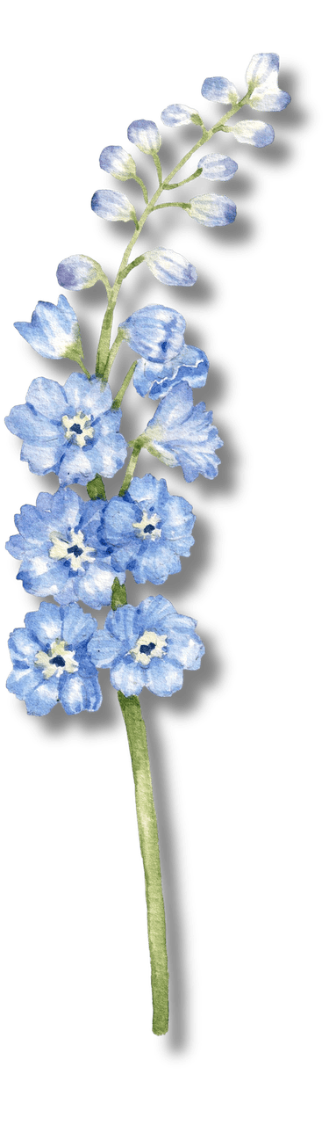
Bloom or Wilt (True or False)
Raise a flower if TRUE and a leaf if FALSE.
The narrator regularly visits the same church every May.
2 points

Slide 18
It is usually a different church each time. Before the war it was mostly the Lourdes Church in Intramuros. Now it is mostly the Pro-Cathedral in San Miguel. It is other churches too. The young girls are the same, the voices are just as young, sweet, and innocent, and the fragrance that of the same May morning..

Slide 19

C
Scent of Meaning
omplete the statement:
"The heavy scent of crushed petals symbolizes _____."
5 points

Slide 20
It is surely not anything like what it is to my brother, Narciso, who has become a Catholic priest. And it can not be like what it is to my sisters, every single one of the seven of them, the living and the dead Victoria. It is certainly not anything like what it was to the dead Victoria. It is not anything like what my brothers know; I can't imagine Juaning doing it; I can't think of Peping doing it either, Ting who is going to medical school would-but it would not be at all the same thing; and Toni? Toni who is going to intermediate school? Perhaps Toni.

Slide 21
And I don't know that it is anything like what Father might have known when he was living; and Mother only does Father's wish. Father might have known it; if he did, it was surely before Victoria died-not after, hardly after.

Slide 22

Floral Tableau
In 20 seconds, create a frozen scene showing one moment from the church celebration.
10 points

Slide 25
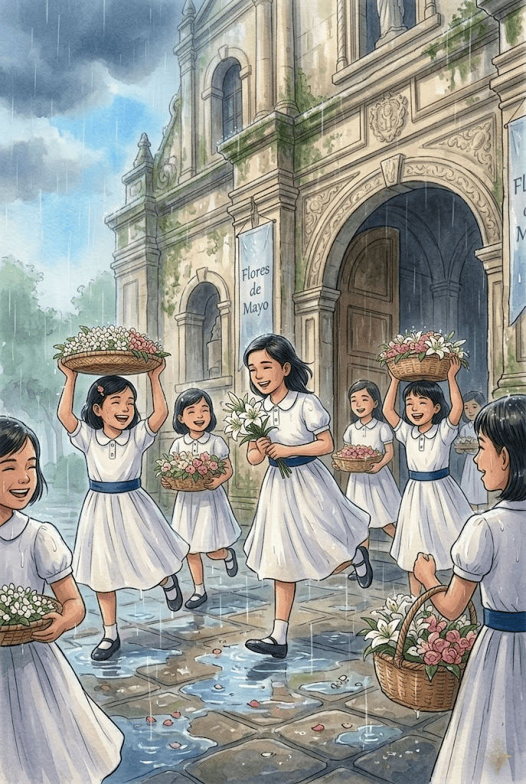
MAYTIME IS AN afternoon in May. The year is 1934. It is the year of Victoria's death. It is an afternoon in May and Victoria has been dead two months.
It is three o'clock in the afternoon and Father has just come home from office. He has just taken off his coat. It begins to rain. (It has been warm and threatening to rain all afternoon.)
Father walks to the window and watches the rain. The picture of father standing by the window watching the rain makes me think of Verlaine.
The tears fall in my heart
Like rain upon the town.

Slide 26

Read the Rain
If the rain could speak, what would it say about Father?
3 points

Slide 27
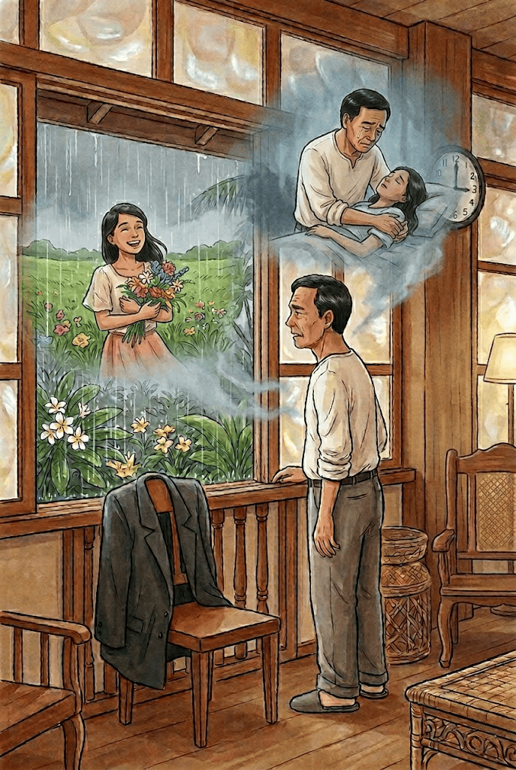
Father is thinking of my sister, Victoria. It rained in the afternoon of her burial. Victoria has been dead two months. Victoria died in March. She was almost a young lady when she died. She was sixteen. She had been ill a long time. It was May the year before when she was taken ill. She was out in the country gathering flowers for the flower festival when she was caught in the rain. It was rain like this one Father now is watching. (The rain is falling in sheets; you can't see through it or around it.) She was ill a long time-ten months. March this year she was dead. May last year was the last May she ever saw.

Slide 28
It was also the last time she ever participated in the floral rites. She had been one of the singing flower girls since she was six. Nine years. Nine years is a long time to be a singing flower girl. It was about time. She died in Father's arms. I think Victoria is Father's first real, and as it turns out, only loss. Josefina who and before her died in early infancy and Concepcion who died after her as stillborn. It has been two months since Victoria died and we buried her and Father has not said her name once or even spoken of her.

Slide 29


How would you describe the father? Choose one word that best describes Father's emotional state.
Scan this and Drop your answers on Personal Interpretation Post (Class Discussion)
3 points

Slide 30
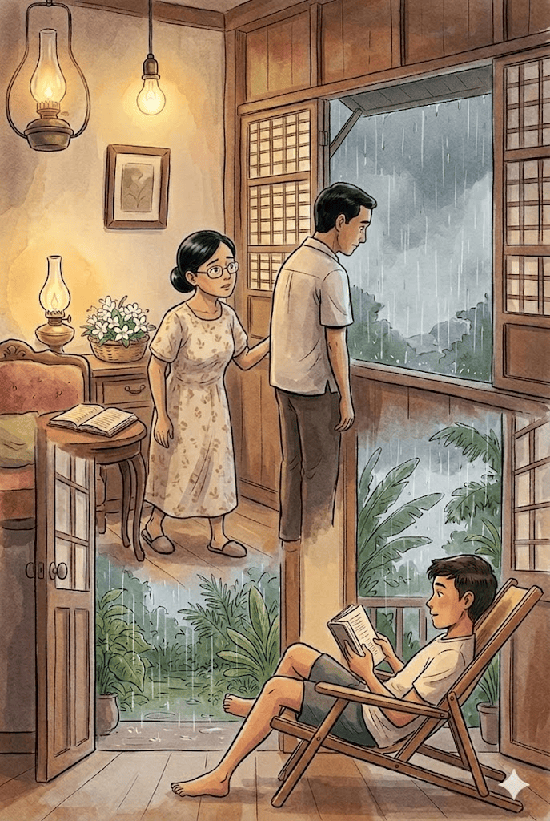

Mother appears at the door. She has her double-vision glasses with the wire frame (it looks deceptively fragile) on. She has been doing some sewing or reading from one of her innumerable copies of a weekly in the vernacular where she follows all the interminable serials. She looks at Father. She walks to him. She walks without making a sound.
"I didn't hear you come," Mother says.
Father turns and looks down at her but does not say anything. Mother smiles a little. Father turns back to the window and looks up at the sky.
"Manuela is out piano-teaching," Mother says.
Father knows this; he does not answer.
"Juaning is in the hospital, he is on twenty-four-hour duty today; he won't be home until tomorrow," Mother says.
Father knows this too; he has no comment to make.
"Paking is somewhere in the house reading." Mother says.

Slide 31
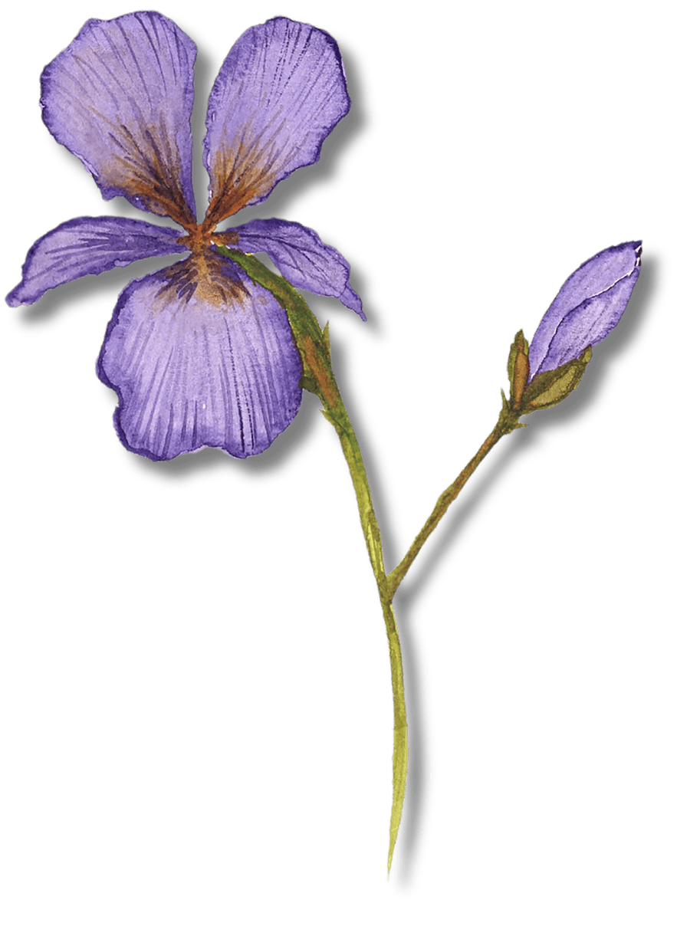
Unspoken Petals
Mother tries to start a conversation, but Father barely responds. What does this interaction reveal about the emotional atmosphere within the family?
2 points

Slide 32
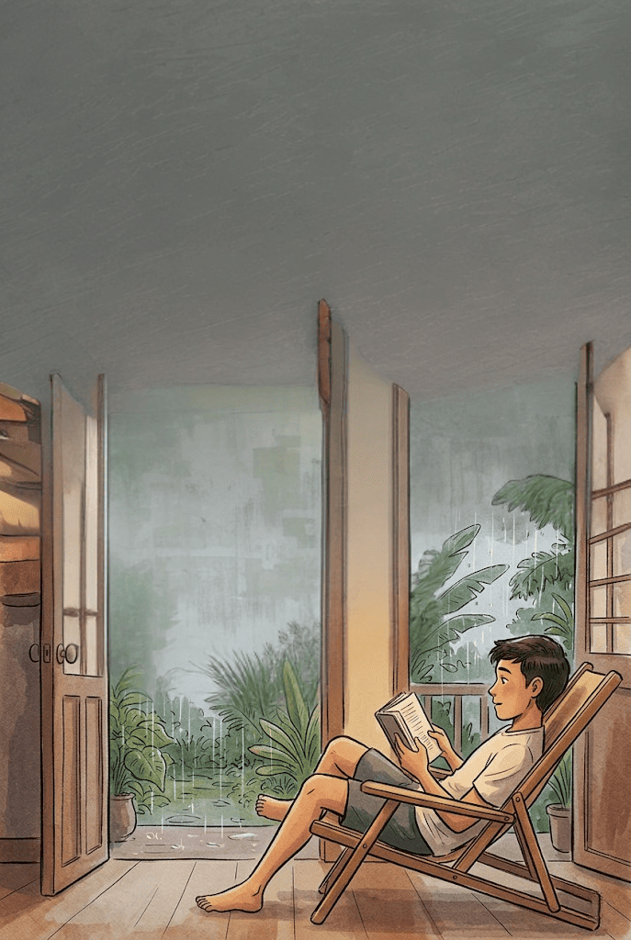
I am in a beach chair near the door (which is open) leading to the patio. I am reading. Father already knows this too, he saw me when he came up; he has nothing to say.
Mother goes on volunteering information about us, things Father already knows, to make conversation. Father listens with an abstracted air and does not say anything.
Mother looks up at the rain. "I hope the girls have sense enough to stay out of the rain," she says.

Slide 33
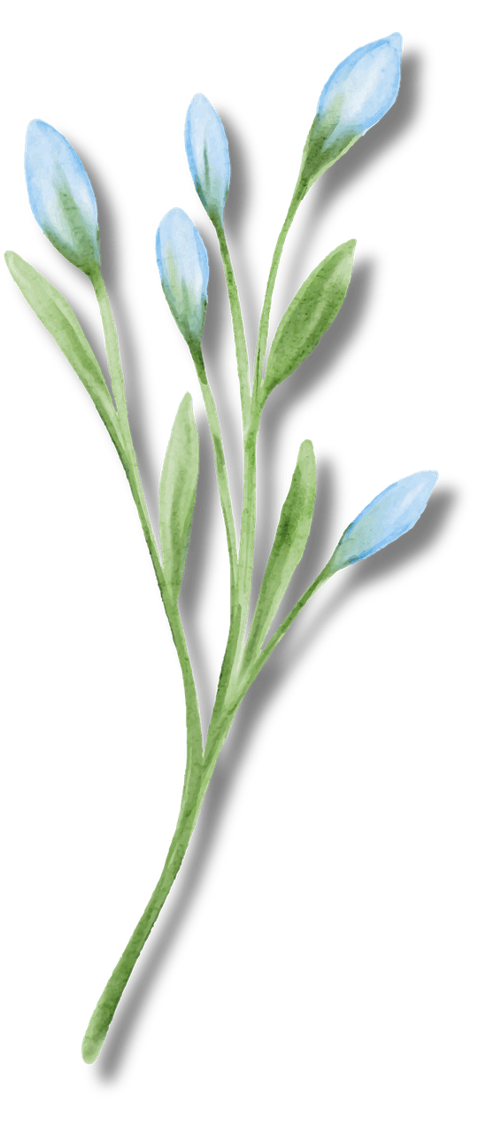
Unspoken Petals
What do you think this line means:
"I hope the girls have sense enough to stay out of the rain," she says.
4 points

Slide 36
Petal Sketch
Task:
In 30 seconds, sketch what will happen next.
4 points

Slide 37
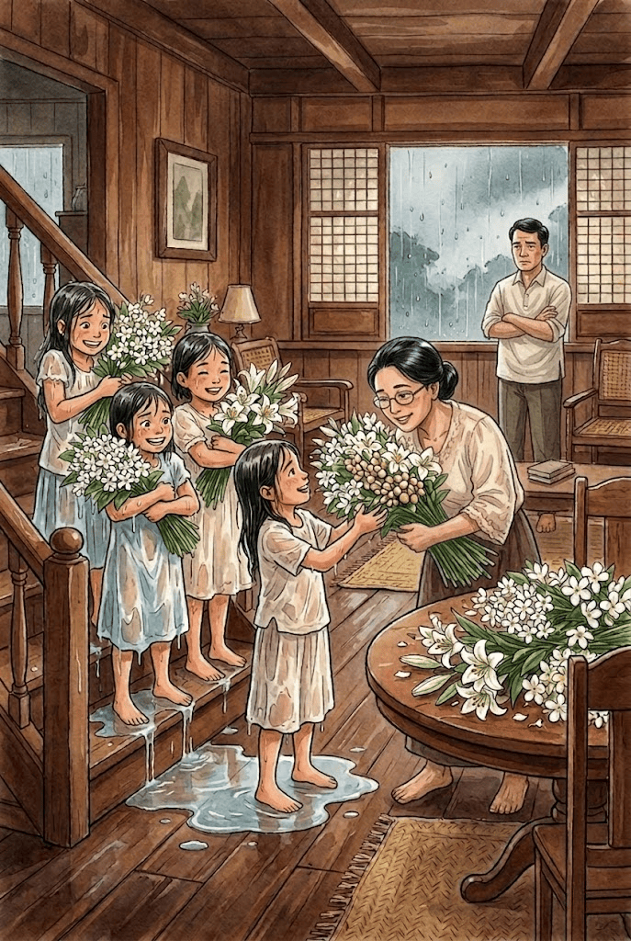
Father and Mother are still at the window when the girls arrive. They are drenched but their arms are full of flowers, all the flowers of May. They have more flowers than they have ever been able to gather before.
The girls stand at the head of the stairs dripping rainwater. There is not a stitch of dry clothing on them. A pool of rainwater gathers about their feet. Streams of rainwater are dripping down the steps.
They stand at the stair head, their arms heavy with flowers, their hair wet and sticking to their faces, their faces that you can barely see above the flowers bright and happy like the flowers, their eyes that you can barely see through the flowers, Punch-pleased and shining brightly like the flowers.

Slide 38
Mother runs to them; "What have you done to yourselves?" she asks. She gathers the flowers from their shaky arms into her more steady ones; "What fresh and fragrant flowers! What lovely lilies!" she exclaims; carries the flowers to the round table in the middle of the sala; raises the flowers to her face and holds them there a moment before spilling them out carefully on to the tabletop.
Father has turned around from the window and now, against the murky light he stands, not saying anything, just watching.

Slide 39

Bloom Mood
Assign 3 emojis to each character:
  Father
  Mother
  The Girls
Explain each one Emoji
5 points

Slide 40
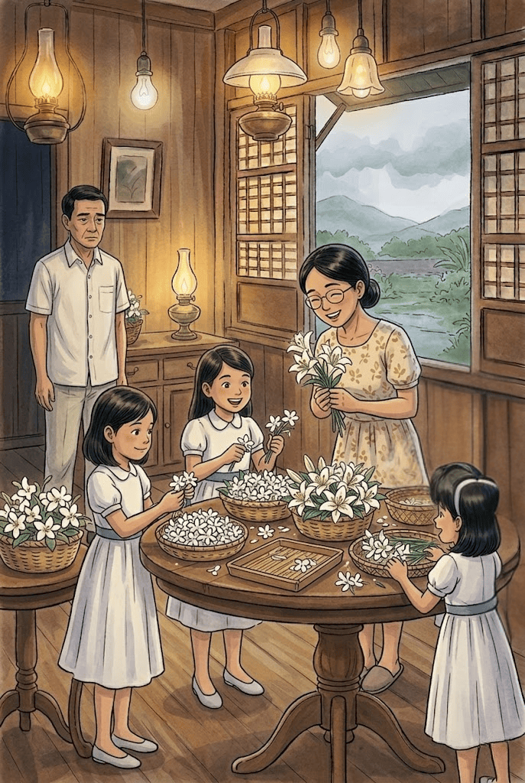
The girls pick up their trays and walk to the round table where the flowers are. Mother picks up the tea things and carries them out to the kitchen. She returns, hovers about the girls who are gathered about the flowers. Mother does not look much taller than the girls or much older, she may well be one of them. Fussing a great deal, the girls arrange the flowers in their trays.
"What beautiful blossoms! What fresh and fragrant flowers! What lovely lilies!" Mother enthuses.
The girls look up at Mother with bright pleased happy faces.
"Take some of the lilies, Mother," they offer. "Take some of the lilies for our own chapel."
"Well, now," Mother says. "That is a sweet idea. Don't you think it is sweet of the girls to offer me some of their lilies, Pepeng?" Mother turns to Father brightly.
Father does not say anything.
"I do not think I'll take some," Mother says. "I'll take three lilies, just three, only three and no more-one from each of your trays. I shall take the least among your lilies."

Slide 41
S
elect a flower!

Slide 44
Place the Lily
Before revealing the next story segment, each group receives a paper chapel and a paper lily. They must decide where to place the third lily and explain why.
(After all groups share, the next part of the story is revealed, allowing them to compare their predictions with Arcellana's actual resolution.)

Slide 45
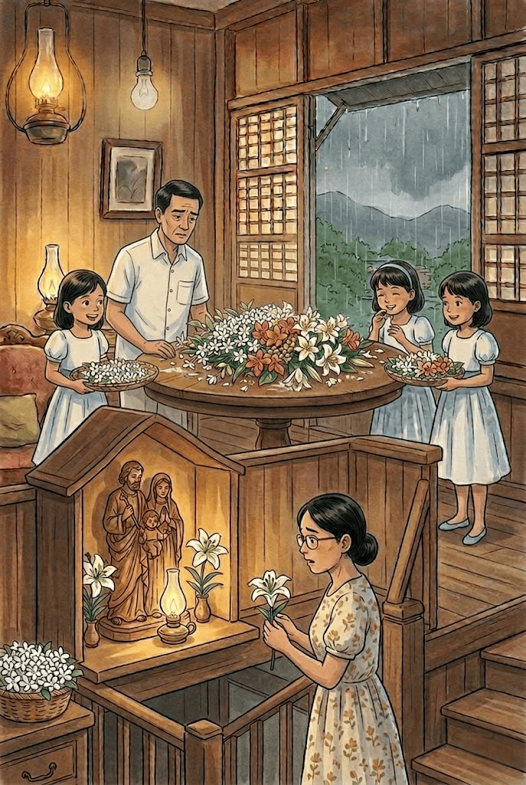
Mother picks up one lily and then another and then still another. She holds the lilies in her arms as if they are a bride's bouquet. She carries the lilies to the family chapel built in the cubicle that partially roofs the strairwell where an oil lamp burns all night and day before a Holy Family.
Mother stands before the graven group, the three lilies lying in her arms like a bride's bouquet.
Father and the girls watch Mother's little play with what she calls the least among the lilies.

Slide 46
Mother picks up one lily and places it to the right of the Holy Family. She picks up the second lily and sets it to the left. But when she picks up the third lily she hesitates: she does not quite know what to do with the third lily.
The girls laugh at Mother's little impasse with the third lily. Father watches quietly.
Mother is a long time about the third lily. She falls into an agony over it. She holds it like a candle in her hand-the long stem secure against her palm, the green stalk caught between her thumb and fingers, the lily leaning forward like candleflame and does not know what to do about it

Slide 47
The girls finish their trays; they turn now to attend to Mother's contest with the lily. Father stands silent watching Mother at her play.
It does not look like Mother will ever be able to resolve her little drama with the odd lily: no climax is in sight.
The girls pick up their trays, ready to go.
Mother is silent and still, in an agony over the last lily. The girls walk toward the stairs.

Slide 48
Predict the Petal
Mother easily places the first two lilies, but hesitates with the third.
What do you think is making her hesitate?

Slide 51
The sound of the rain on the roof has unaccountably stopped.

Slide 52
What Happens Next?
The girls are leaving.
Mother is still holding the lily.
Father remains silent.
Predict what will happen next.
4 points

Slide 53
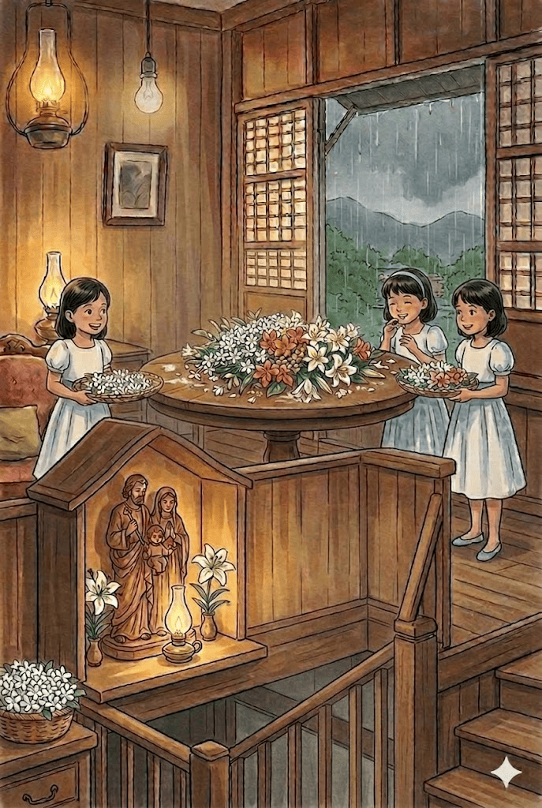

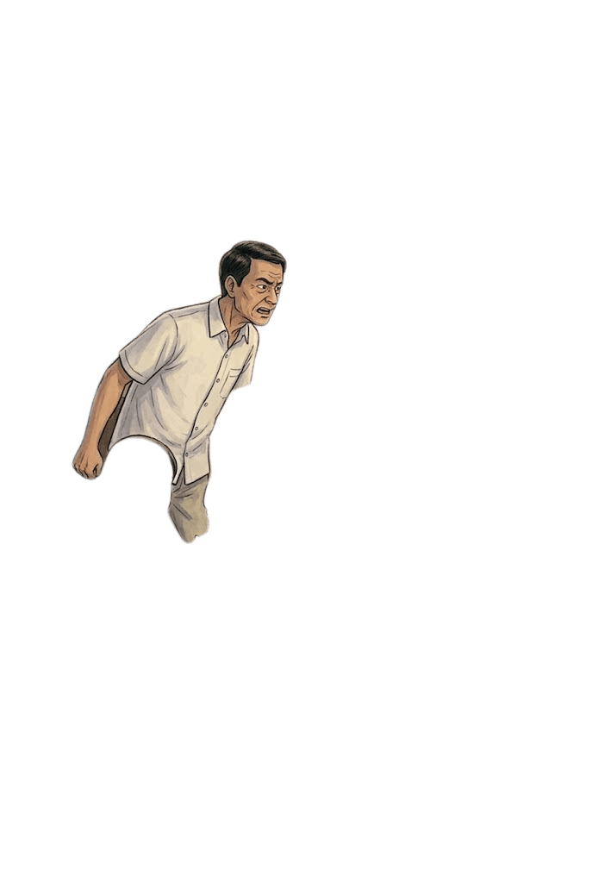
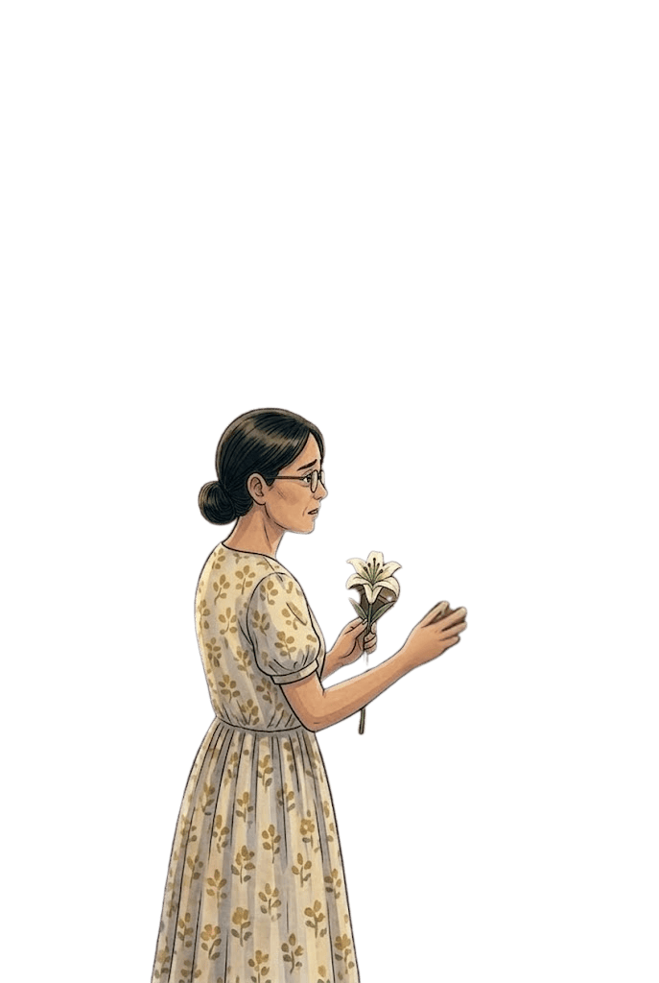
"Enough of this!"
Someone has suddenly spoken.
It is Father speaking. There is a stridency, strange and urgent, in his voice.
The girls stop where they are halfway between the center of the sala and the stairhead, midway between Father standing by the round table and Mother in the family chapel.
"Enough, enough of this," Father says.
Mother hears but does not turn, she does not dare turn. She is very still but not the lily in her hand. She is very still but the lily is agitated in her hand.
"I have had enough," Father says.

Slide 54
Mother twirls the green stalk a long time before she realizes what she is doing. Then she stills the lily, wills it to stillness, stills herself, wills herself to stillness that is very much like death.

Slide 55
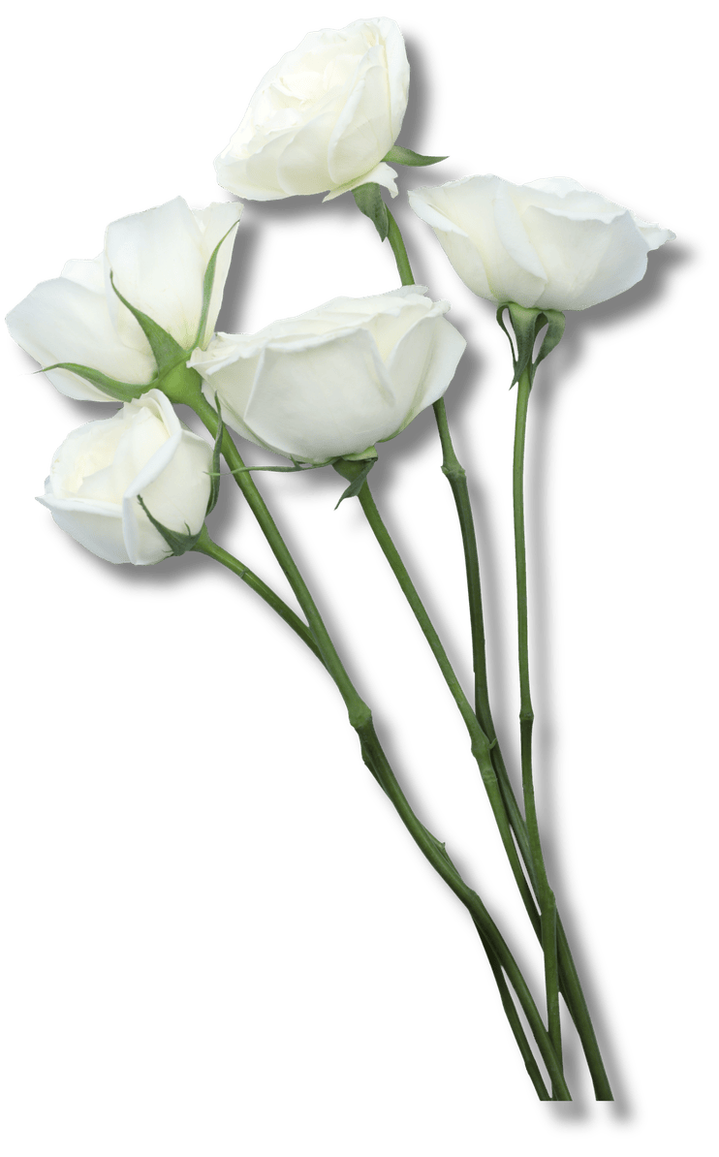
Why do you think the father continues to say, “Enough of this”? What made him say that?
4 points

Slide 56
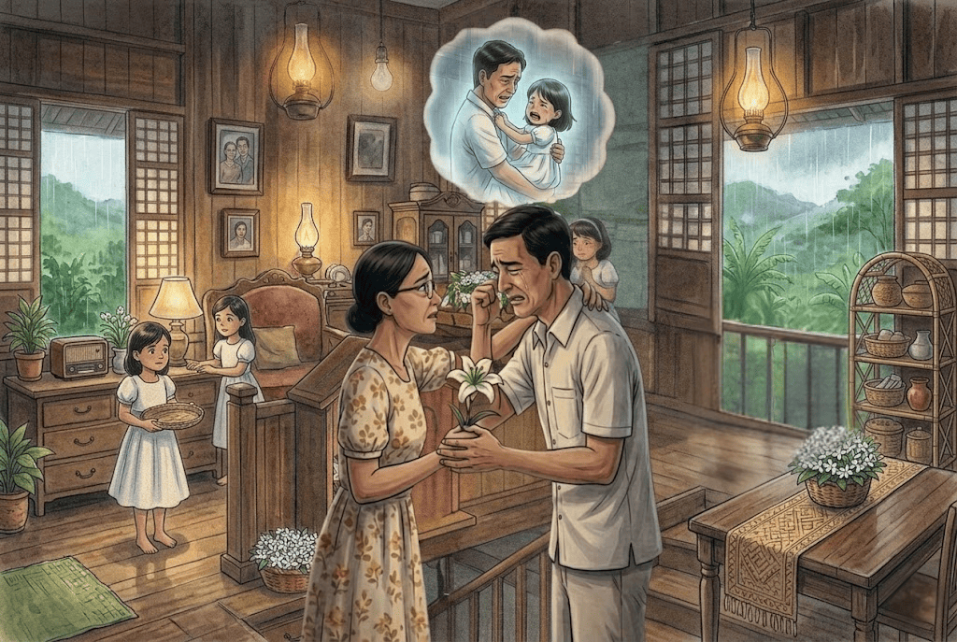
She turns and confronts Father.
"Enough of what, Pepeng?" Mother asks brightly. "What have you had enough of?"
"I won't have any more of it," Father says.
The girls are still and silent, in a shock of listening.
"What would you have no more of?" Mother asks.
"Do you think it is easy to watch your child die before your eyes?" Father demands in a voice loud and unnatural.
"Do you think it is so simple to let your child die?" Father demands again!

Slide 57

Heart Petal
If you were standing in the room, what would you say to Father after hearing his outburst?
One sentence only.
2 points

Slide 58
"O Pepeng," Mother cries, her mouth a little parted as if she is in pain, her hand that holds the lily rigid as if it is hurting her.
Father proclaims: "Victoria did not want to die!"
His grief has found utterance at last.
"Victoria did not want to die," Father reiterates. "I saw that she did not want to die."
Mother cries "O Pepeng, stop," but Father will not stop. Father will not be consoled.
"The flowers are gone. The flowers of May are gone. I saw that Victoria did not want to die. There was nothing I could do. There was nothing one could do," Father says helplessly.
His grief is terrible and deep.

Slide 59

What does Father's statement, "The flowers of May are gone." MOST likely symbolize?
A. The festival has ended.
B. Victoria's death and lost innocence.
C. The weather has changed.
D. The flowers have wilted.
B
2 points

Slide 60
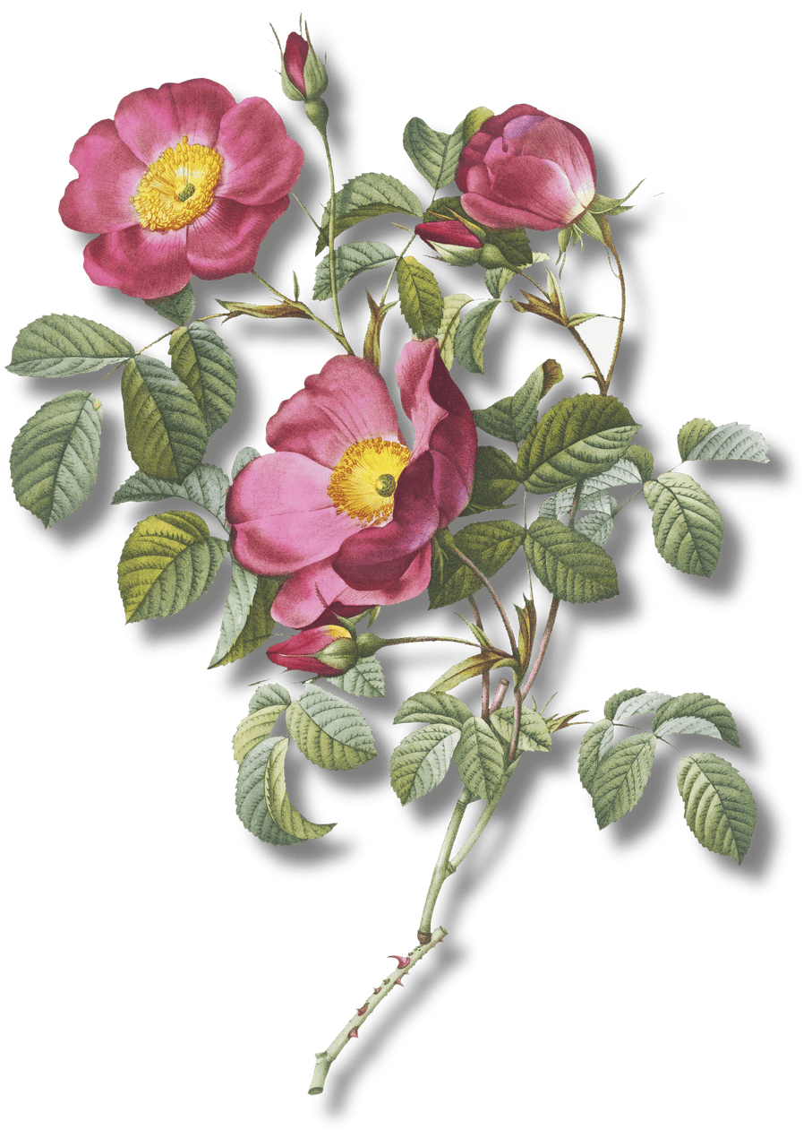
The Loudest Line
Which line do you think carries the most emotional weight?
Choose one and explain why:
  "Victoria did not want to die."
  "There was nothing I could do."
  "The flowers of May are gone."
  "I have had enough."
5 points

Slide 61
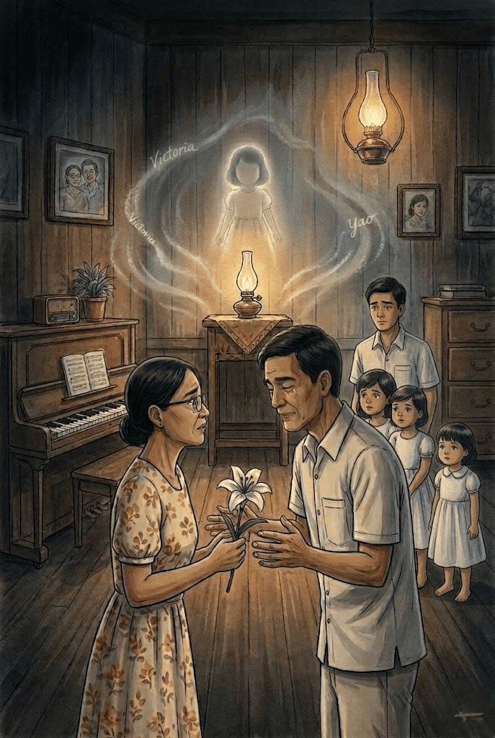
It is as terrible as the naked terror stark in Mother's eyes and deep as the new knowledge and first and final and only wisdom that we have just now begun to share. So this is death. So this is what it means to die. And for the first time since she died and we buried her, we learn to accept the fact of Victoria's death finally, we know at least that Victoria is dead really and truly dead.

Slide 62
"The Bouquet of Understanding"
  Each member of the group writes one lesson they learned from the story on a flower-shaped paper.
  The flower is added to the group's bouquet.

Slide 63
P
etals
of Remembrance

Slide 64
P
etals
of Remembrance
  After visiting all locations and completing the challenges, arrange the flowers your group has collected into a bouquet. The number, variety, and value of the flowers in your bouquet will reflect your group's understanding of and engagement with The Flowers of May.

Slide 65
P
etals
of Remembrance
  Once your bouquet is complete, dedicate it to a person you cherish, treasure, admire, or appreciate. Write a short dedication of two to three sentences explaining why you chose this person and connect your message to a lesson, value, or realization you gained from the story.

Slide 66
P
etals
of Remembrance
  Finally, present your bouquet to the class. Share the flowers you collected, your total points, the recipient of your bouquet, and your dedication message. Through your presentation, show how the flowers you gathered have blossomed into a meaningful offering of gratitude and appreciation.

Slide 67
P
etals
of Remembrance
  Finally, present your bouquet to the class. Share the flowers you collected, your total points, the recipient of your bouquet, and your dedication message. Through your presentation, show how the flowers you gathered have blossomed into a meaningful offering of gratitude and appreciation.

Slide 68
T
He May
Flower Trail

Slide 69
T
He May
Flower Trail
  This activity is a story sequencing game based on The Flowers of May by Francisco Arcellana.
  Carefully examine each image and identify the event or scene it represents from The Flowers of May.
  Using your understanding of the story, drag and arrange the images in the correct chronological order based on how the events unfold.

Slide 74
Whose Memory Lives On?
W
ho among the family members mentioned in the passage have already passed away?
Victoria, Josefina, Concepcion
3 points

Slide 75
Rain of Emotions
W
hy does Father stand by the window watching the rain?
4 points

Slide 76
T
Mapping Memories
he passage mentions many churches and places the narrator has visited. What do these places mainly symbolize?
A. The narrator's favorite destinations
B. The family's wealth and travels
C. The memories, experiences, and people connected to Maytime traditions
D. The locations where flowers are sold
6 points
C

Slide 77
I
Petals of Remembrance
n 10 words or less, complete the statement:
"Maytime is not only about flowers; it is also about __________."
8 points

Slide 78
F
What Was Never Said?
ather remains silent throughout much of the scene.
Write one sentence that might be inside Father's thoughts as he looks at the flowers.
3 points

Slide 79
C
Floral Tableau
reate a frozen tableau of one scene:
  Mother admiring the flowers
  The girls arriving from the rain
  Father staring at the flowers
Classmates guess the scene.
If they are wrong, you earn 5 points; If they are right, you earn 1 point

Slide 80
Flowers of Emotions
T
he flowers make the girls happy, Mother grateful, but Father silent.
How can the same object carry different meanings for different people?
4 points

