Slide 1

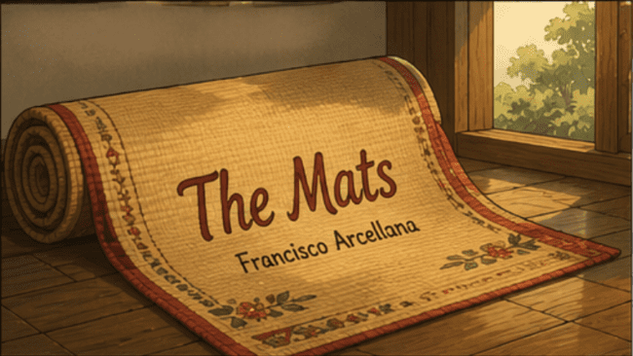

Slide 2
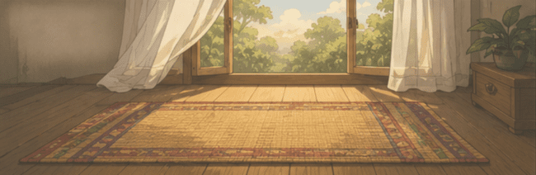
OBJECTIVES:
At the end of the discussion, learners are expected to:
Identify key characters, symbols, and central theme of Francisco Arcellana’s short story, “The Mats”;
Express personal insights about the story through creative responses and reflective activities;
Demonstrate empathy and emotional awareness by recognizing the experiences of love, loss, and remembrance portrayed in the story; and
Observe how the author reflects family bonds, and relatable human experiences and traditions in the short story.

Slide 3
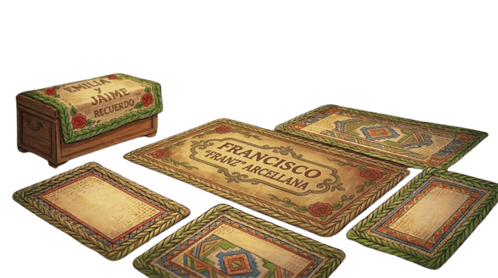


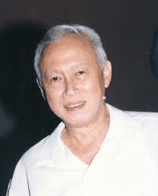
FRANCISCO “FRANZ” ARCELLANA

Slide 4
FRANCISCO “FRANZ” ARCELLANA
September 6, 1916 – August 1, 2002
  Filipino writer, poet, essayist, critic, journalist, and teacher whose fiction helped shape the modern Filipino short story in English.
  Proclaimed National Artist in 1990
  Winner of 1995 Philippines National Book Award for Children’s Literature, The Mats
  He developed fiction with lyrical language, careful imagery, and emotional restraint, qualities that make his works valuable for close reading and annotation.

Slide 5
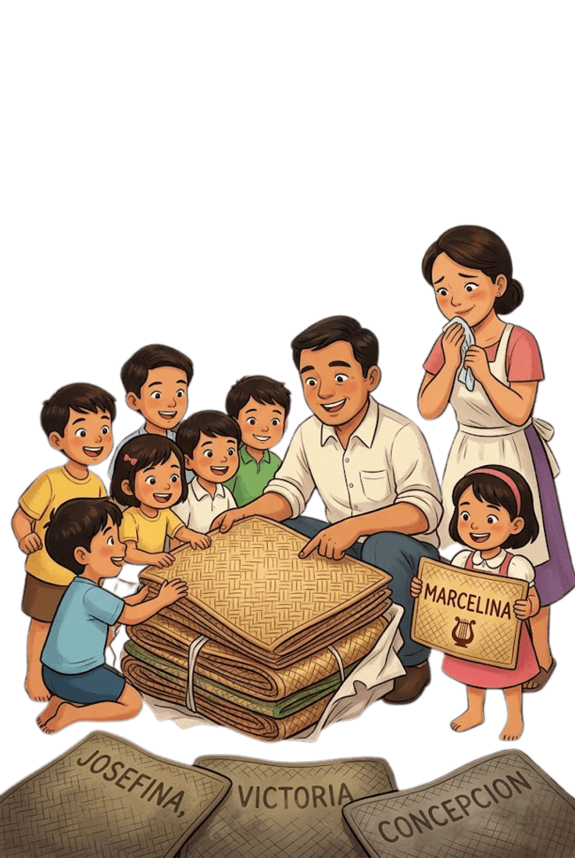

FRANCISCO ARCELLANA

Slide 6
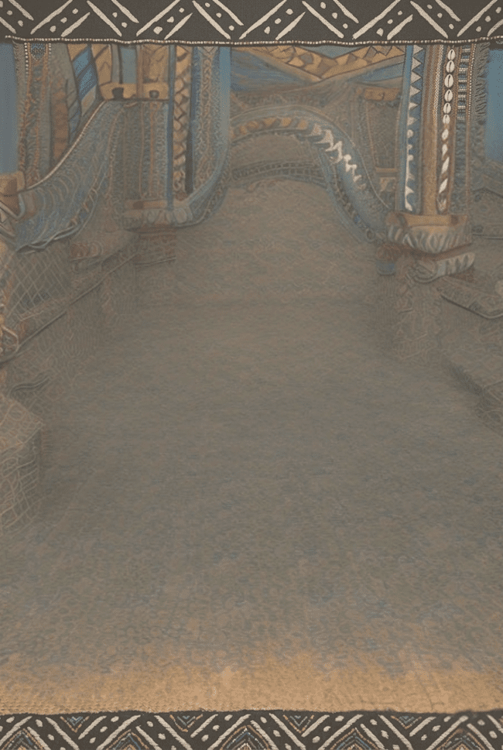
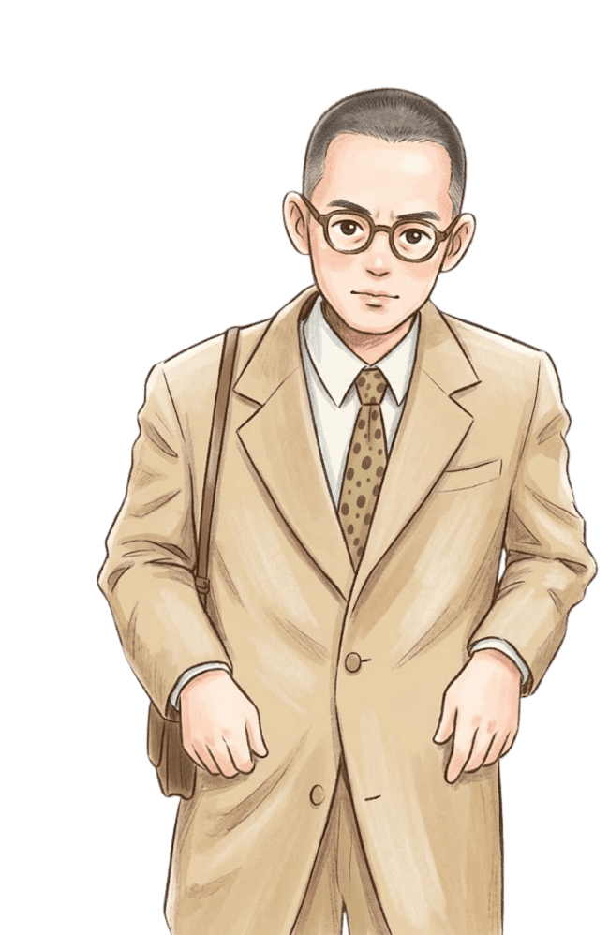
Let the readings, begin!
Hi! I am Franz! You all ready for the story?
For every correct answer, you will receive mat strips. The number varies each challenge
Be prepared! You will never know when it will appear.
Well, you must! Today, everyone of you will embark on a challenge.

Slide 7
THE MATS
Francisco Arcellana
M
arcelina's father returns from a trip to the southern provinces with a bundle of sleeping mats for his family. Each mat has the child's name woven into it. Each mat is designed to suit the child's personality.
But three additional mats remain in Father's bundle...
In this landmark adaptation, evocative of Philippine culture, Francisco Arcellana's classic story "The Mats" remains and as powerful as when it first cared more than fifty years ago. The mats serve as a metaphor for the bitter sweet mix of love, laughter and loss woven into the fabric of everyday life.

Slide 8
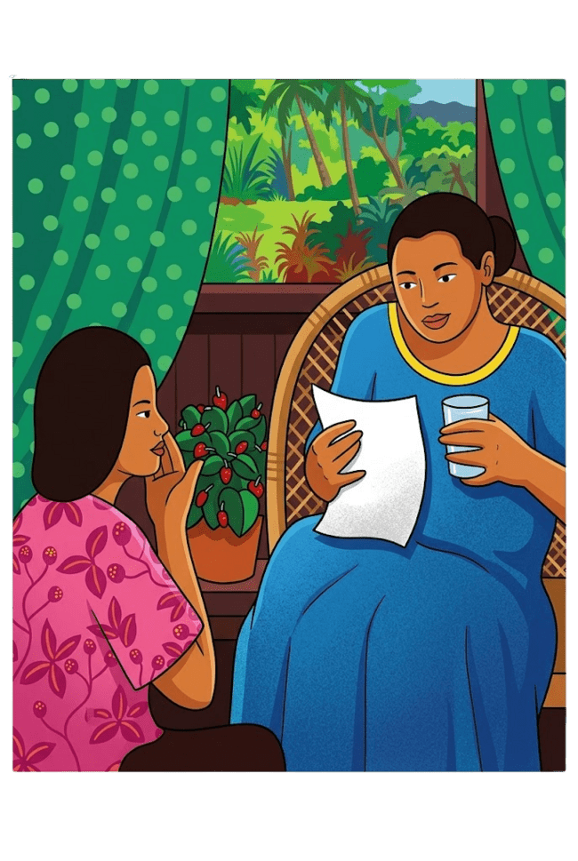
F
or my family, Papa’s homecoming from his many inspection trips around the Philippines was always an occasion to remember. But there was one homecoming-from a trip to the south–that turned out to be more memorable than any of the others.
Papa was an engineer. He inspected new telegraph lines for the government. He had written from Lopez, Tayabas:
I have just met a marvelous matweaver–a real artist–and I shall have a surprise for you. I asked him to weave a sleeping mat for every one of the family. I can hardly wait to show them to you…

Slide 9
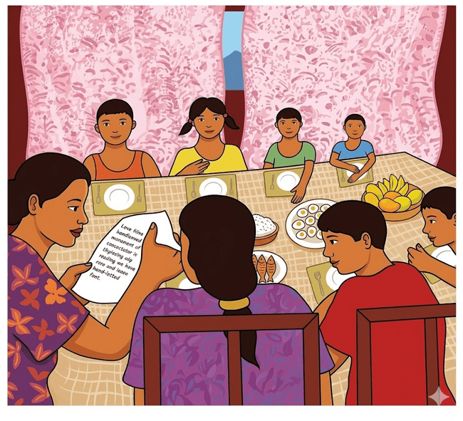
Mama read Papa’s letter aloud during the noon meal. Talk about the mats flared up like wildfire.
“I like the feel of mats,” said my brother Antonio. “I like the smell of new mats.”
“Oh, but these mats are different,” said Susanna, my younger sister. “They have our names woven into them. There is a different color for each of us.”
After a few days Papa wrote again:
I am taking the Bicol Express tomorrow. I have the mats with me, and they are beautiful. I hope to be home to join you for dinner.

Slide 10


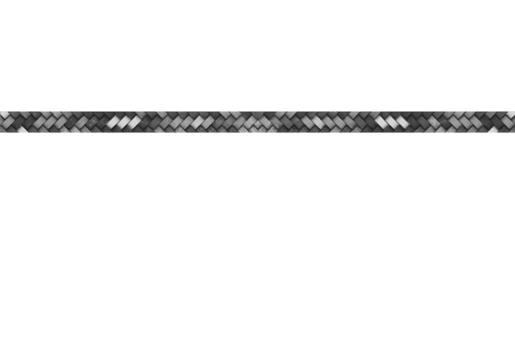


Huraaay! Here is your 5 mat strips. Get now!
Ooopps! Challenge appeared
I will give you 5 mat strips once you complete the mission.
My challenge:
In 10 secs, draw the pasalubong you got from someone. Share to us why it matters.

Slide 11
Since you did well, and you are the fastest to finish the challenge, I have an offer.
Ooopps! Wait! Give it back. I have a deal for you

Slide 12
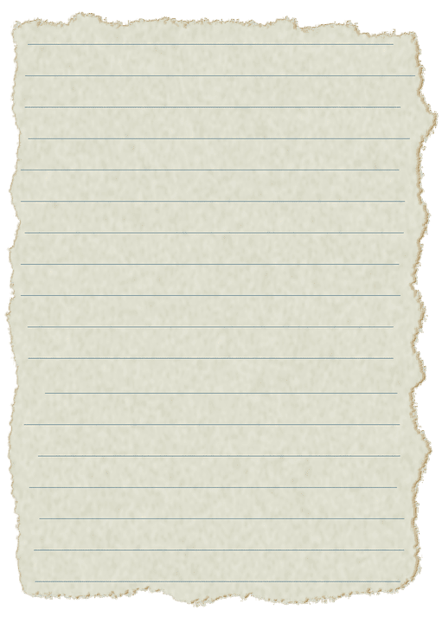
Franz’s deal:
I’ll give you
10 strips for answering my question right.
Great job.
Here’s my deal:
DEAL!
NO DEAL!

Slide 13
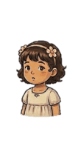
You got canned!
Here’s
3 strip.

Slide 14
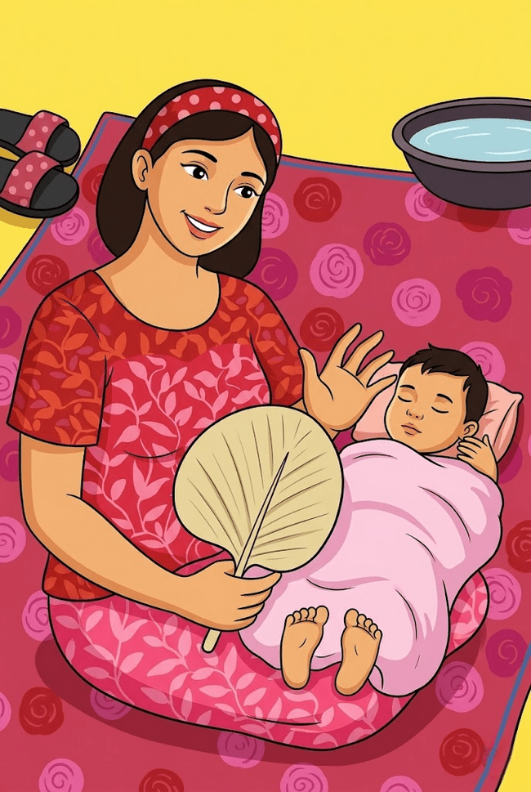
A mat was not something new to us. There was already one such mat in the house. It was one we seldom use, a mat older than any of us.
This mat had been given to Mama by her mother when Mama and Papa were married. It had been with them ever since. It was used on their wedding night and afterwards only on special occasions. It was a very beautiful mat. It had green leaf borders and gigantic red roses woven onto it. In the middle it said:
Emilia y Jaime Recuerdo
The mat did not ever seem to grow old. To Mama it was always as new as it had been on her wedding night. The folds and creases always looked new and fresh. The smell was always the smell of a new mat. Watching it was an endless joy.
Mama always kept that mat in her trunk. When any of us got sick, the mat was brought out and the sick child made to sleep on it. Every one of us had at some time in our life slept on it. There had been sickness in our family. And there had been deaths….

Slide 15
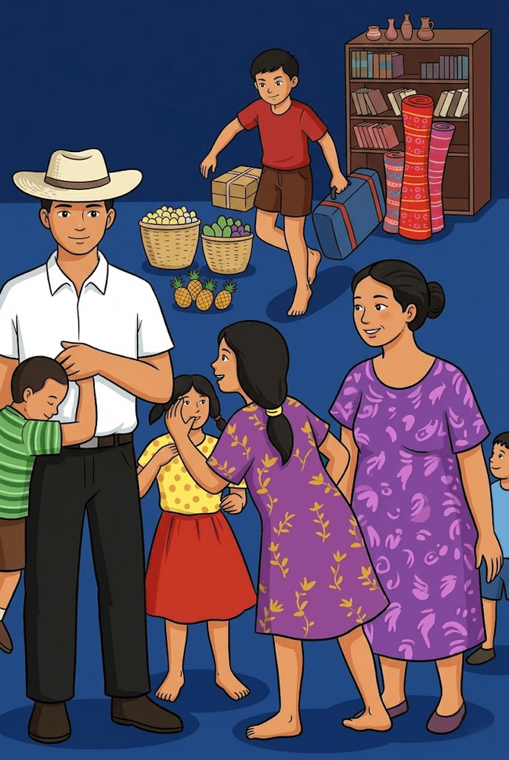
That evening Papa arrived. He had brought home a lot of fruit from the fruit-growing provinces he had passed in his travels. We sampled pineapple, lanzones, chico, atis, santol, watermelon, guayabano, and avocado. He had also brought home a jar of preserved sweets.
Dinner seemed to last forever. Although we tried not to show it, we could hardly wait to see the mats.

Slide 16
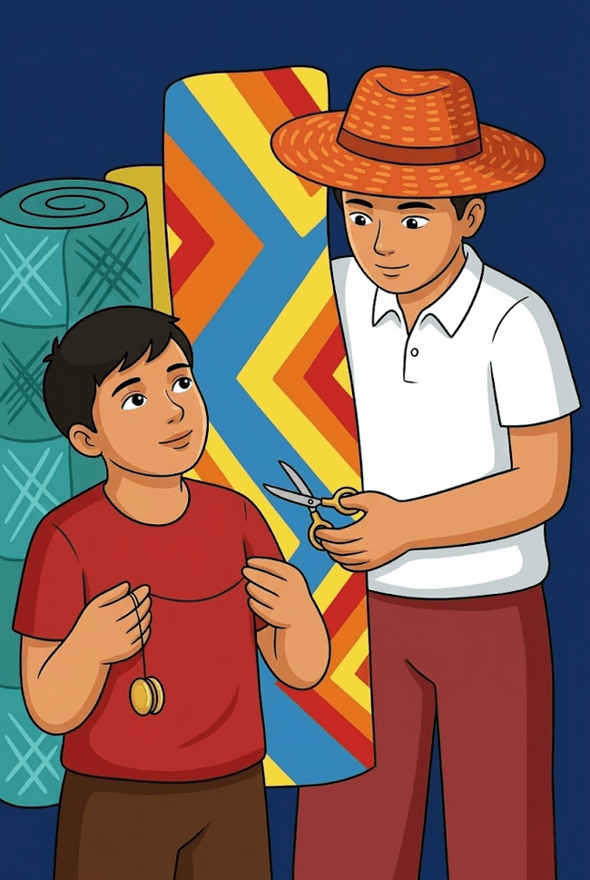
Finally, after a long time over his cigar, Papa rose from his chair and crossed the room. He went to the corner where his luggage was piled. From the heap he pulled out a large bundle. Taking it under his arm, he walked to the middle of the room where the light was brightest. He dropped the bundle to the floor. Bending over and balancing himself on his toes, he pulled at the cord that bound it. It was strong. It would not break. It would not give way. Finally, Alfonso, my youngest brother, appeared at Papa’s side with a pair of scissors.
Papa took the scissors. One swift movement, snip!, and the bundle was loose!

Slide 17
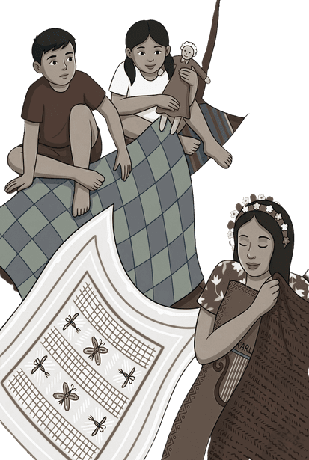
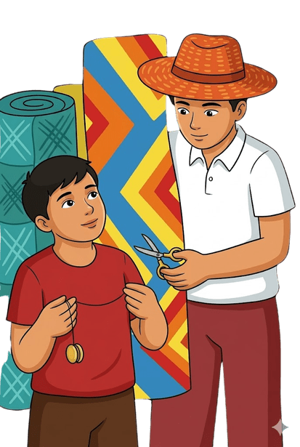
Hey, folks!
Still enjoying my story?
For another worthy deal, answer my question.
Why does the children seem so excited towards the mats?
a. Because it was made by an expert mat-weaver
b. It is a pasalubong from the father’s inspection trip.
c. It has names and symbols on it.

Slide 18
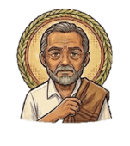

Now, choose 1 from Nana Emilia, and Mr. Angeles.
Why does the children seem so excited towards the mats?
c. It has names and symbols on it.
CORRECT!

Slide 19
INCORRECT!
Give me 2 of your Mat Strips

Slide 20
INCORRECT!
Give me 5 of your Mat Strips

Slide 21
Franz’s deal:
I’ll give you
5 strips for answering my question right.
Great job.
Here’s my deal:
DEAL!
NO DEAL!

Slide 22
You got canned!
Give me
5 strips.

Slide 23
Better luck next time!

Slide 24
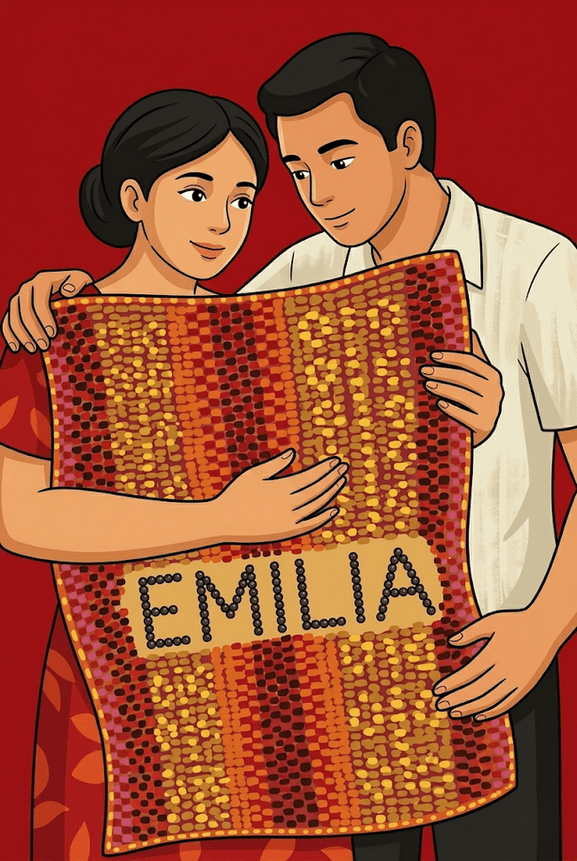
Papa turned to Mama and smiled. "These are the mats, Miling," he said.
He picked up the topmost mat in the bundle.
"This is yours, Miling." Mama stepped forward to the light, wiping her still moist hands against the folds of her apron. Shyly, she unfolded the mat without a word.
We all gathered around the spread mat.
It was a beautiful mat. There was a name in the very center of it: Emilia.
Interwoven into the large, green letters were flowers-cadena de amor.
"It's beautiful, Jaime." Mama whispered, and she could not say any more.

Slide 25
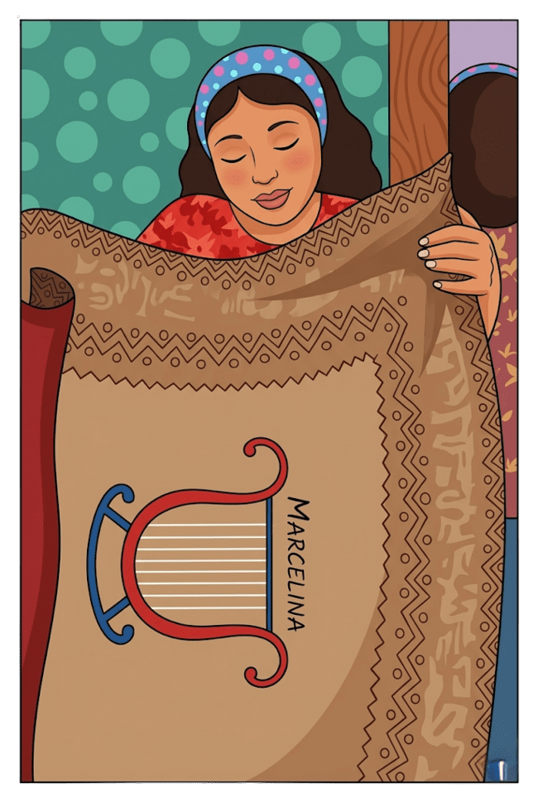
“And this, I know, is my own,” said Papa of the next mat in the bundle. His mat was simple and the only colors on it were purple and cold.
“And this, for you, Marcelina.”
I had always thought my name was too long. Now I was glad to see that my whole name was spelled out on the mat, even if the letters were small. Beneath my name was a lyre, done in three colors. Papa knew I loved music and played the piano. I was delighted with my new mat.

Slide 26
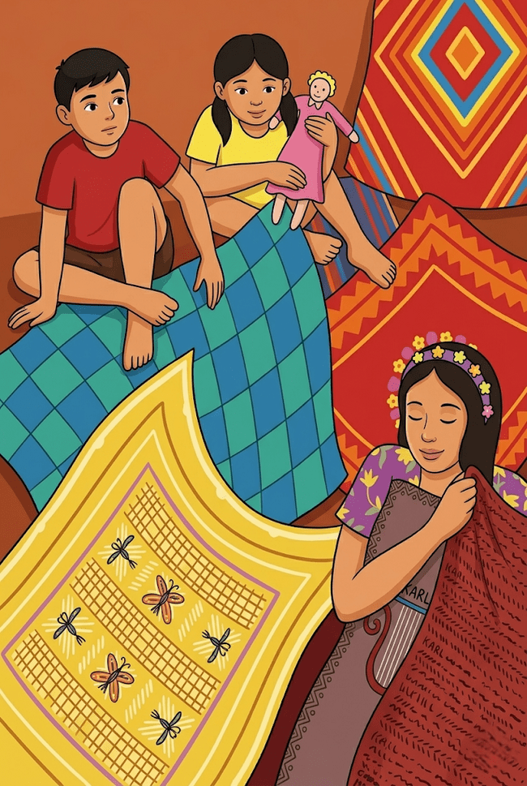
“And this is for you, Jose.” Jose is my oldest brother. He wanted to become a doctor.
“This is yours, Antonio.”
“And this, yours, Juan.”
“And this is yours, Jesus.”
One by one my brothers and sisters stepped forward to receive their mats. Mat after mat was unfolded. On each mat was a symbol that meant something special to each of us.
At last everyone was shown their mats. The air was filled with excited talk.

Slide 27
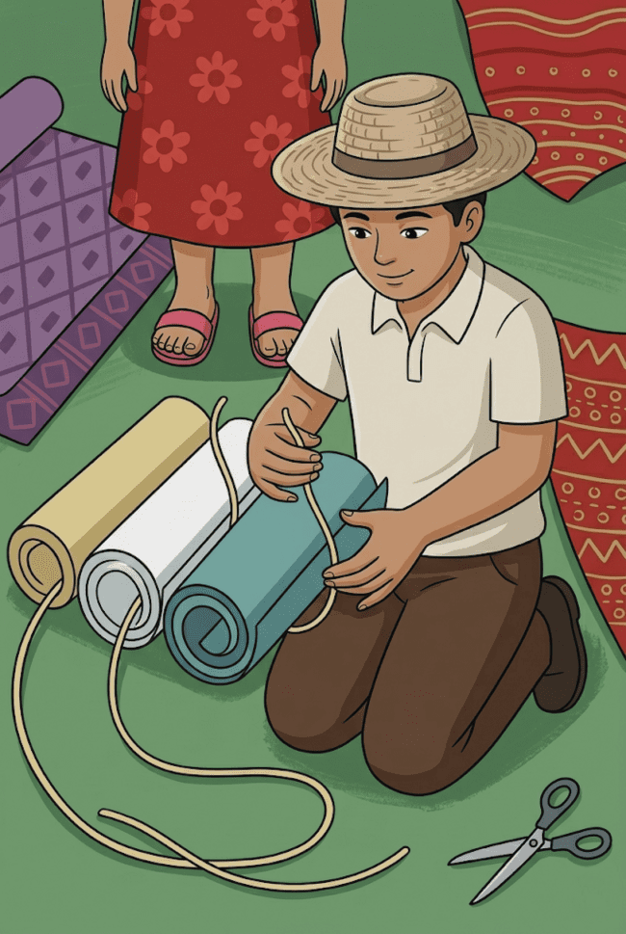
“You are not to use the mats until you go the university,” Papa said.
“But, Jaime,” Mama said, wonderingly, “there are some more mats left in the bundle.”
WHAT DO YOU THINK WILL HAPPEN NEXT? WHAT’S WITH THE LEFT MATS IN THE BUNDLE?
(for 6 mat strips)
WHO ARE THE OFFSPRINGS OF MR. ANGELES AND NANA EMILIA?
(for 4 mat strips)

Slide 28
“You are not to use the mats until you go the university,” Papa said.
“But, Jaime,” Mama said, wonderingly, “there are some more mats left in the bundle.”
“Yes there are three more mats to unfold. They are for the others who are not here…” Papa’s voice grew soft and his eyes looked far away.
“I said I would bring home a sleeping mat for every one of the family. And so I did,” Papa said. Then his eyes fell on each of us. “Do you think I’d forgotten them? Do you think I had forgotten them? Do you think I could forget them?
“This is for you, Josefina!
“And this, for you, Victoria!
“And this, for you, Concepcion!”
Papa’s face was filled with a long-bewildered sorrow.
Then I understood. The mats were for my three sisters, who died when they were still very young.

Slide 29
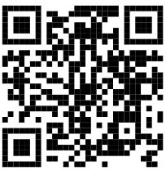
Did you all answer? Here is your 4 strips.
Alright! Let us continue!
Hey, folks!
How are you?
For 4 mat strips answer my question.
As a reader, what did you feel about the revelation of the 3 remaining mats?
Scan this and Drop your answers on Personal Interpretation Post (Class Discussion)

Slide 30

After a long while, Papa broke the silence. “We must not ever forget them,” he said softly. “They may be dead but they are never really gone. They are here, among us, always in our hearts.”
The remaining mats were unfolded in silence. The colors were not bright but dull. I remember that the names of the dead among us did not glow o shine as did the other living names.

Slide 31

The End...

Slide 32
The story ends, but our challenge does not.
For 3 mat strips answer my question.
How will describe the emotional state of Mr. Angeles ?
a. Mr. Angeles became a numb father because of totally rejecting his own pain and suffering over his deceased children.
b. Mr. Angeles is consumed by a deep, long-buried grief over his deceased children that finally erupts during what was meant to be a joyful family gathering.
c. Mr. Angeles feels completely ecstatic and overjoyed because all of his children are healthy, thriving, and celebrating together in perfect health.

Slide 33
Now, choose 1 from Nana Emilia, and Mr. Angeles.
CORRECT!
How will describe the emotional state of Mr. Angeles ?
b. Mr. Angeles is consumed by a deep, long-buried grief over his deceased children that finally erupts during what was meant to be a joyful family gathering.

Slide 34
INCORRECT!
Give me 2 of your Mat Strips

Slide 35
INCORRECT!
Give me 5 of your Mat Strips

Slide 36
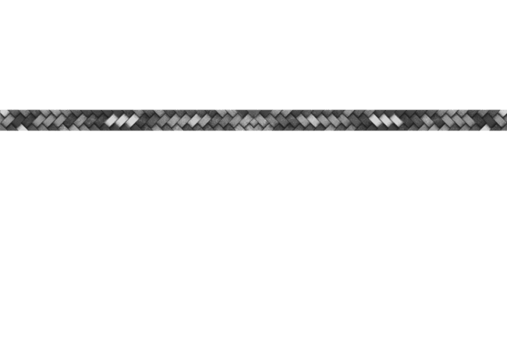


Franz’s deal:
I’ll give you
8 strips for answering my question right.
Great job.
Here’s my deal:
DEAL!
NO DEAL!

Slide 37
You got canned!
Here is
3 strips.

Slide 38
Better luck next time!

Slide 39
In case you are wondering, the mat strips you received has a purpose.
You will create a personalized mat and give it to your special someone. Have a short description with it.

Slide 40
FRANCISCO ARCELLANA

